Slide 1

Notes:
- Microsoft Research, June 2023
- phi-1 — first model of the Phi family
- reference to "Attention Is All You Need" Transformer paper

Slide 2
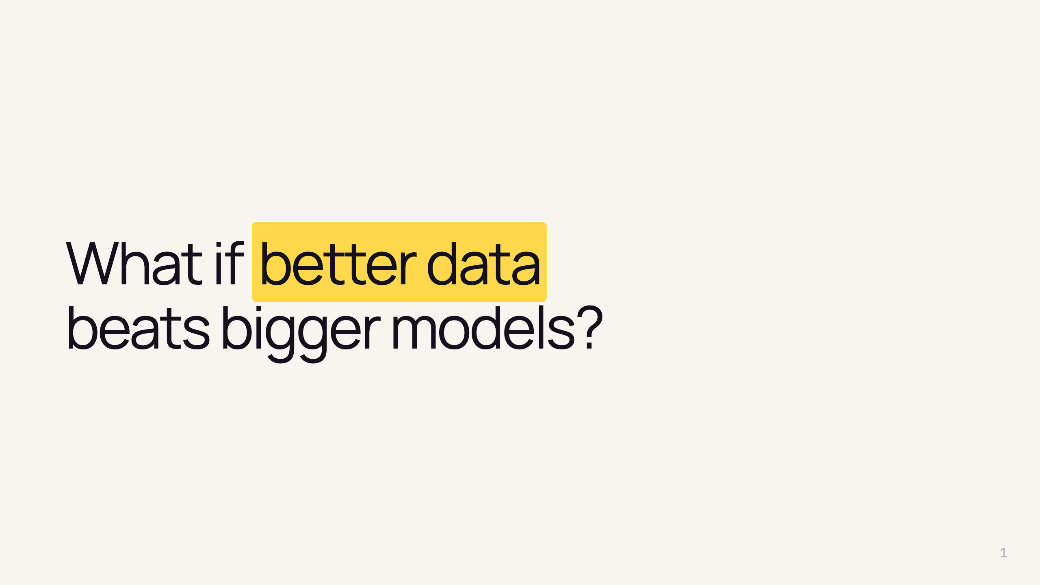
Notes:
- One-sentence thesis of the paper
- Instead of more params / more compute → better data
- How much of an LLM's quality is data vs size?
- Better for ecology

Slide 3
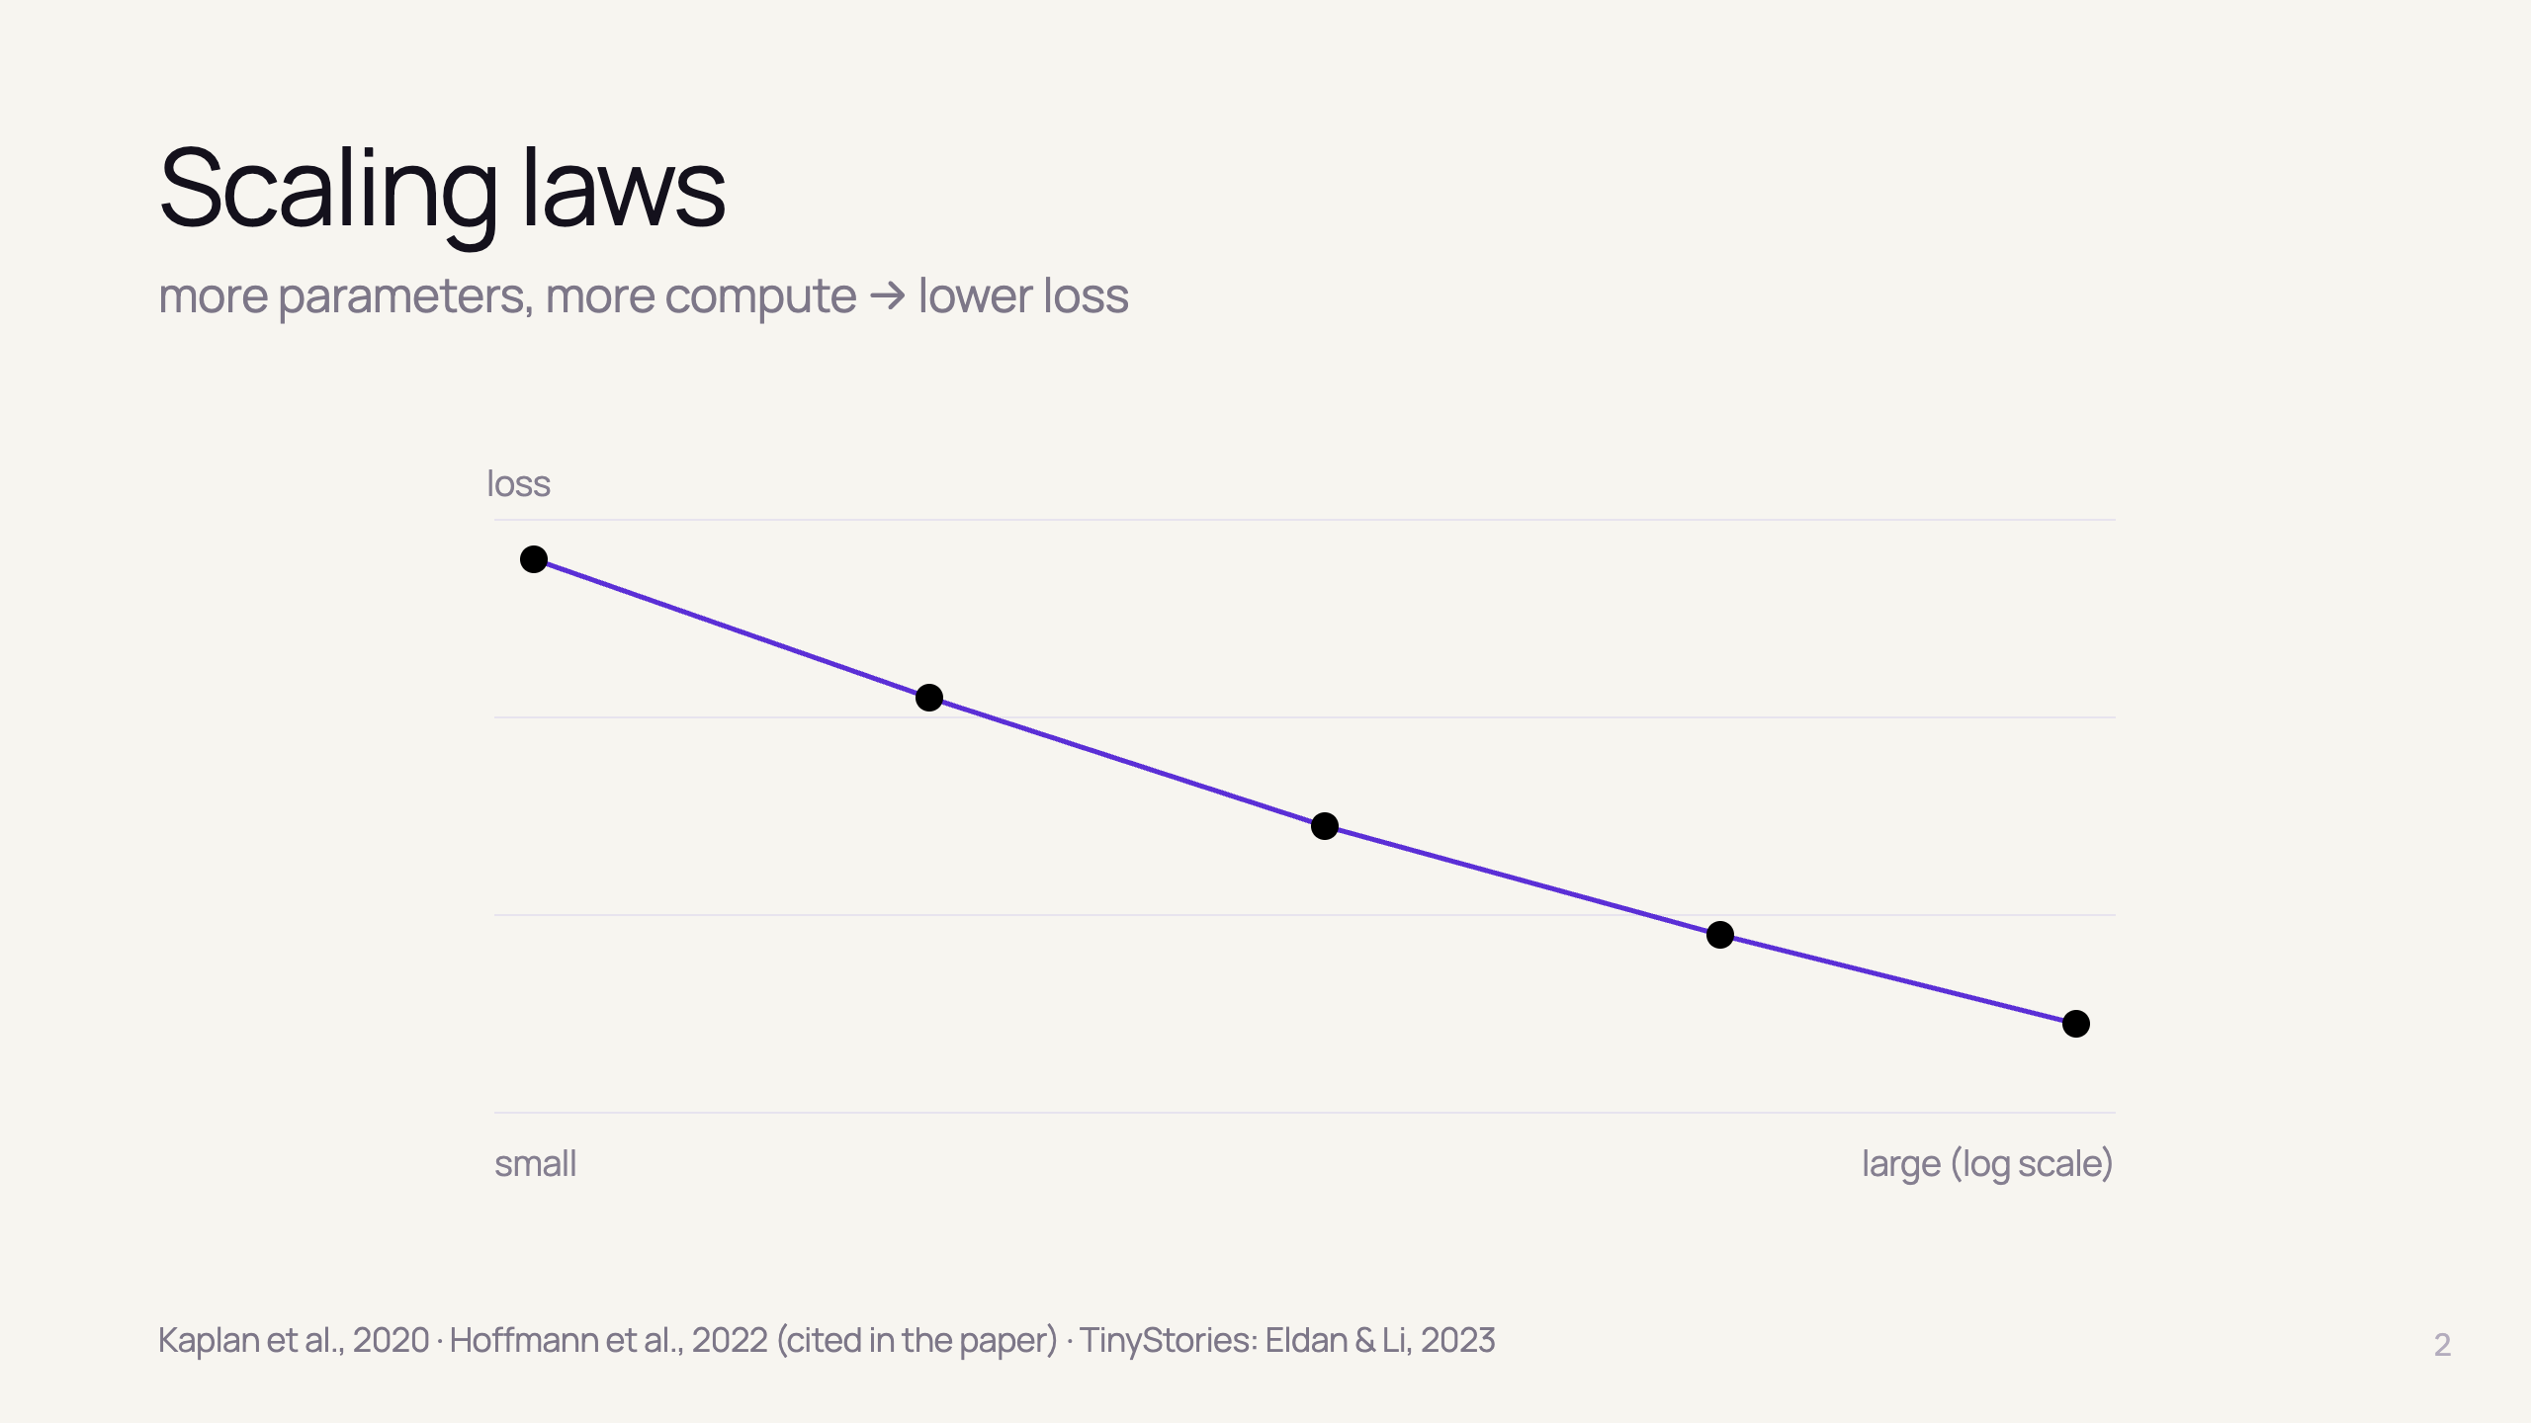
Notes:
- Scaling laws: loss falls predictably as a power laws
- Two classic knobs: parameters, compute
- ignored data QUALITY
- Inspiration: TinyStories (same authors) — synthetic simple stories, tiny models speak fluent English
- This paper: does it work for a code task

Slide 4
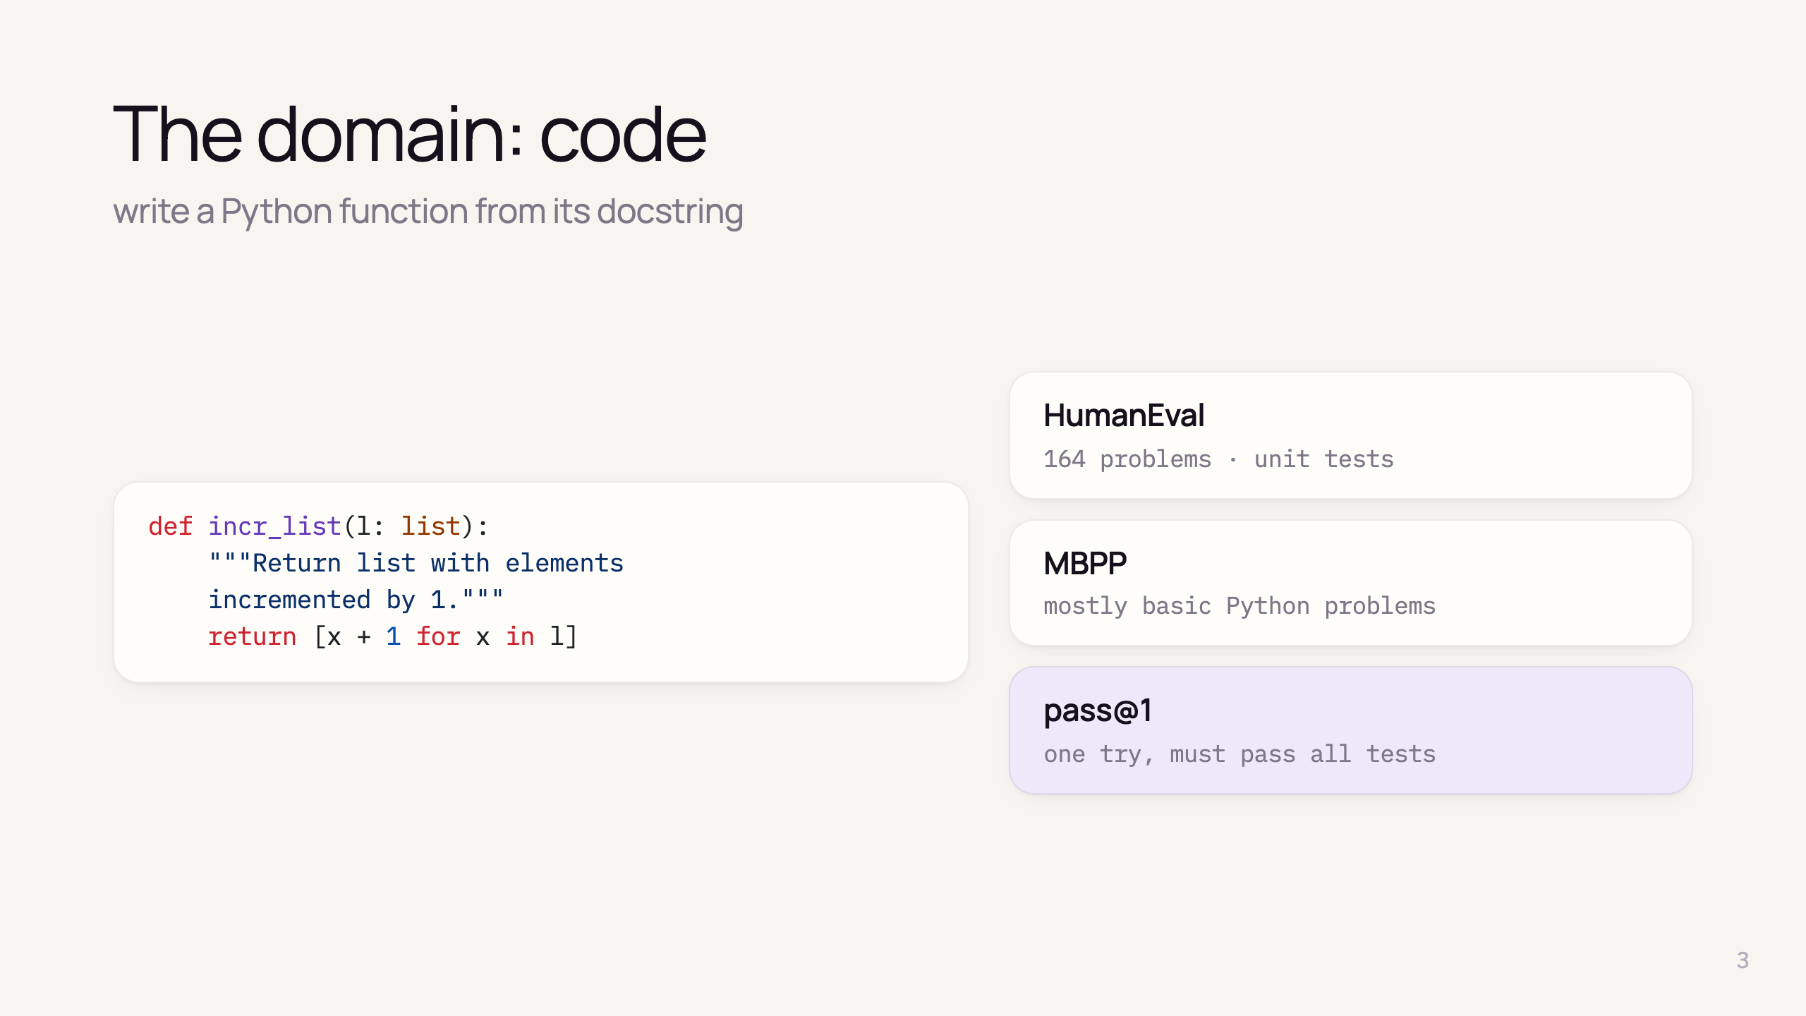
Notes:
- Build simple Python functions from docstrings
- HumanEval: code benchmark - unit tests
- MBPP - basic programs benchmark
- pass@1 - single generation, correct or not — strict

Slide 5
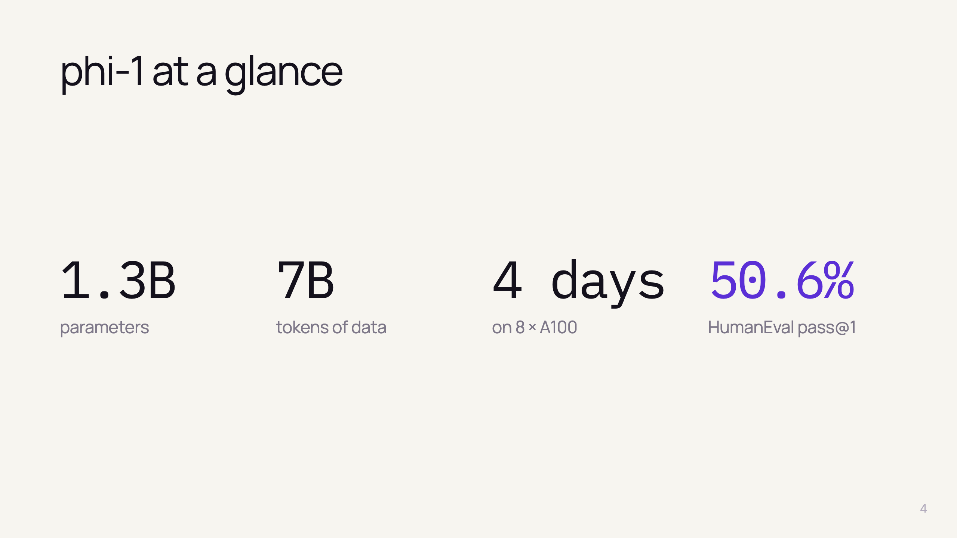
Notes:
- 1.3B params — tiny vs 15B–540B code models of 2023
- 7B unique tokens, ~8 passes → ~50B tokens seen
- Training 4 days on 8 A100 + 7 h finetuning — academic budget
- 50.6% HumanEval, 55.5% MBPP — among best single-generation results (mid-2023)
- phi-1-small (350M) still 45% HumanEval

Slide 6
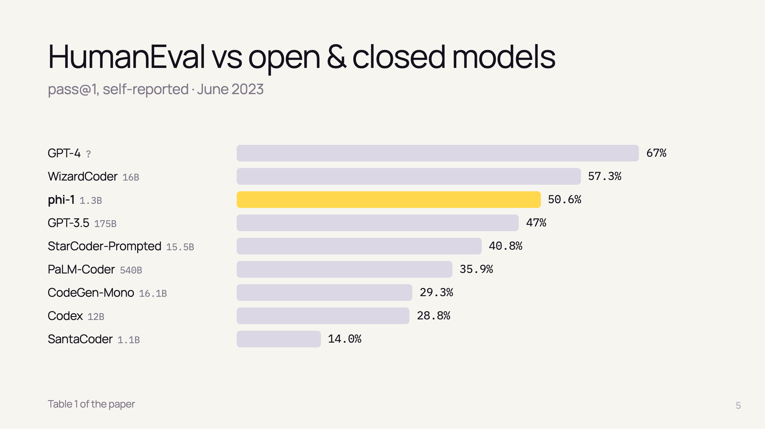
Notes:
- Only GPT-4 beats it clearly
- WizardCoder: better HumanEval, but worse MBPP (51.8 vs 55.5)
- Beats GPT-3.5 (175B) and PaLM-Coder (540B)
- Data size: competitors 100B–1T tokens, phi-1 7B → ~100× less
- WARNING! self-reported scores by paper authors

Slide 7
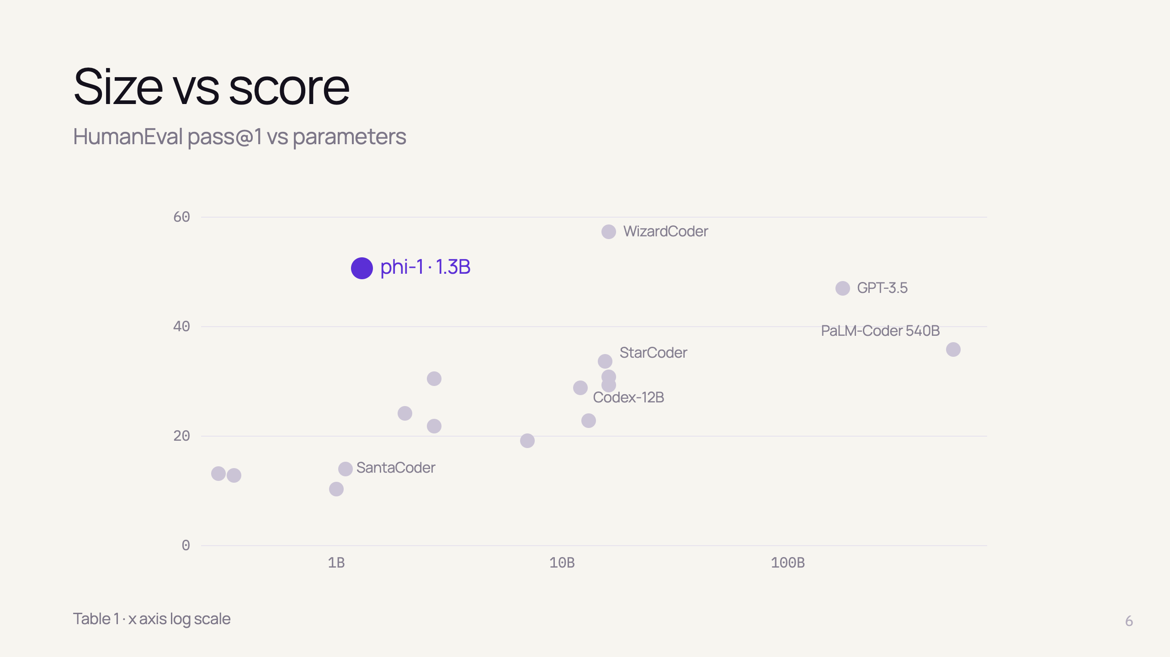
Notes:
- Each dot = one model from Table 1
- Gray cloud: score roughly grows with size
- phi-1 (blue): far above the trend for its size
- Visual version of "breaking scaling laws"

Slide 8
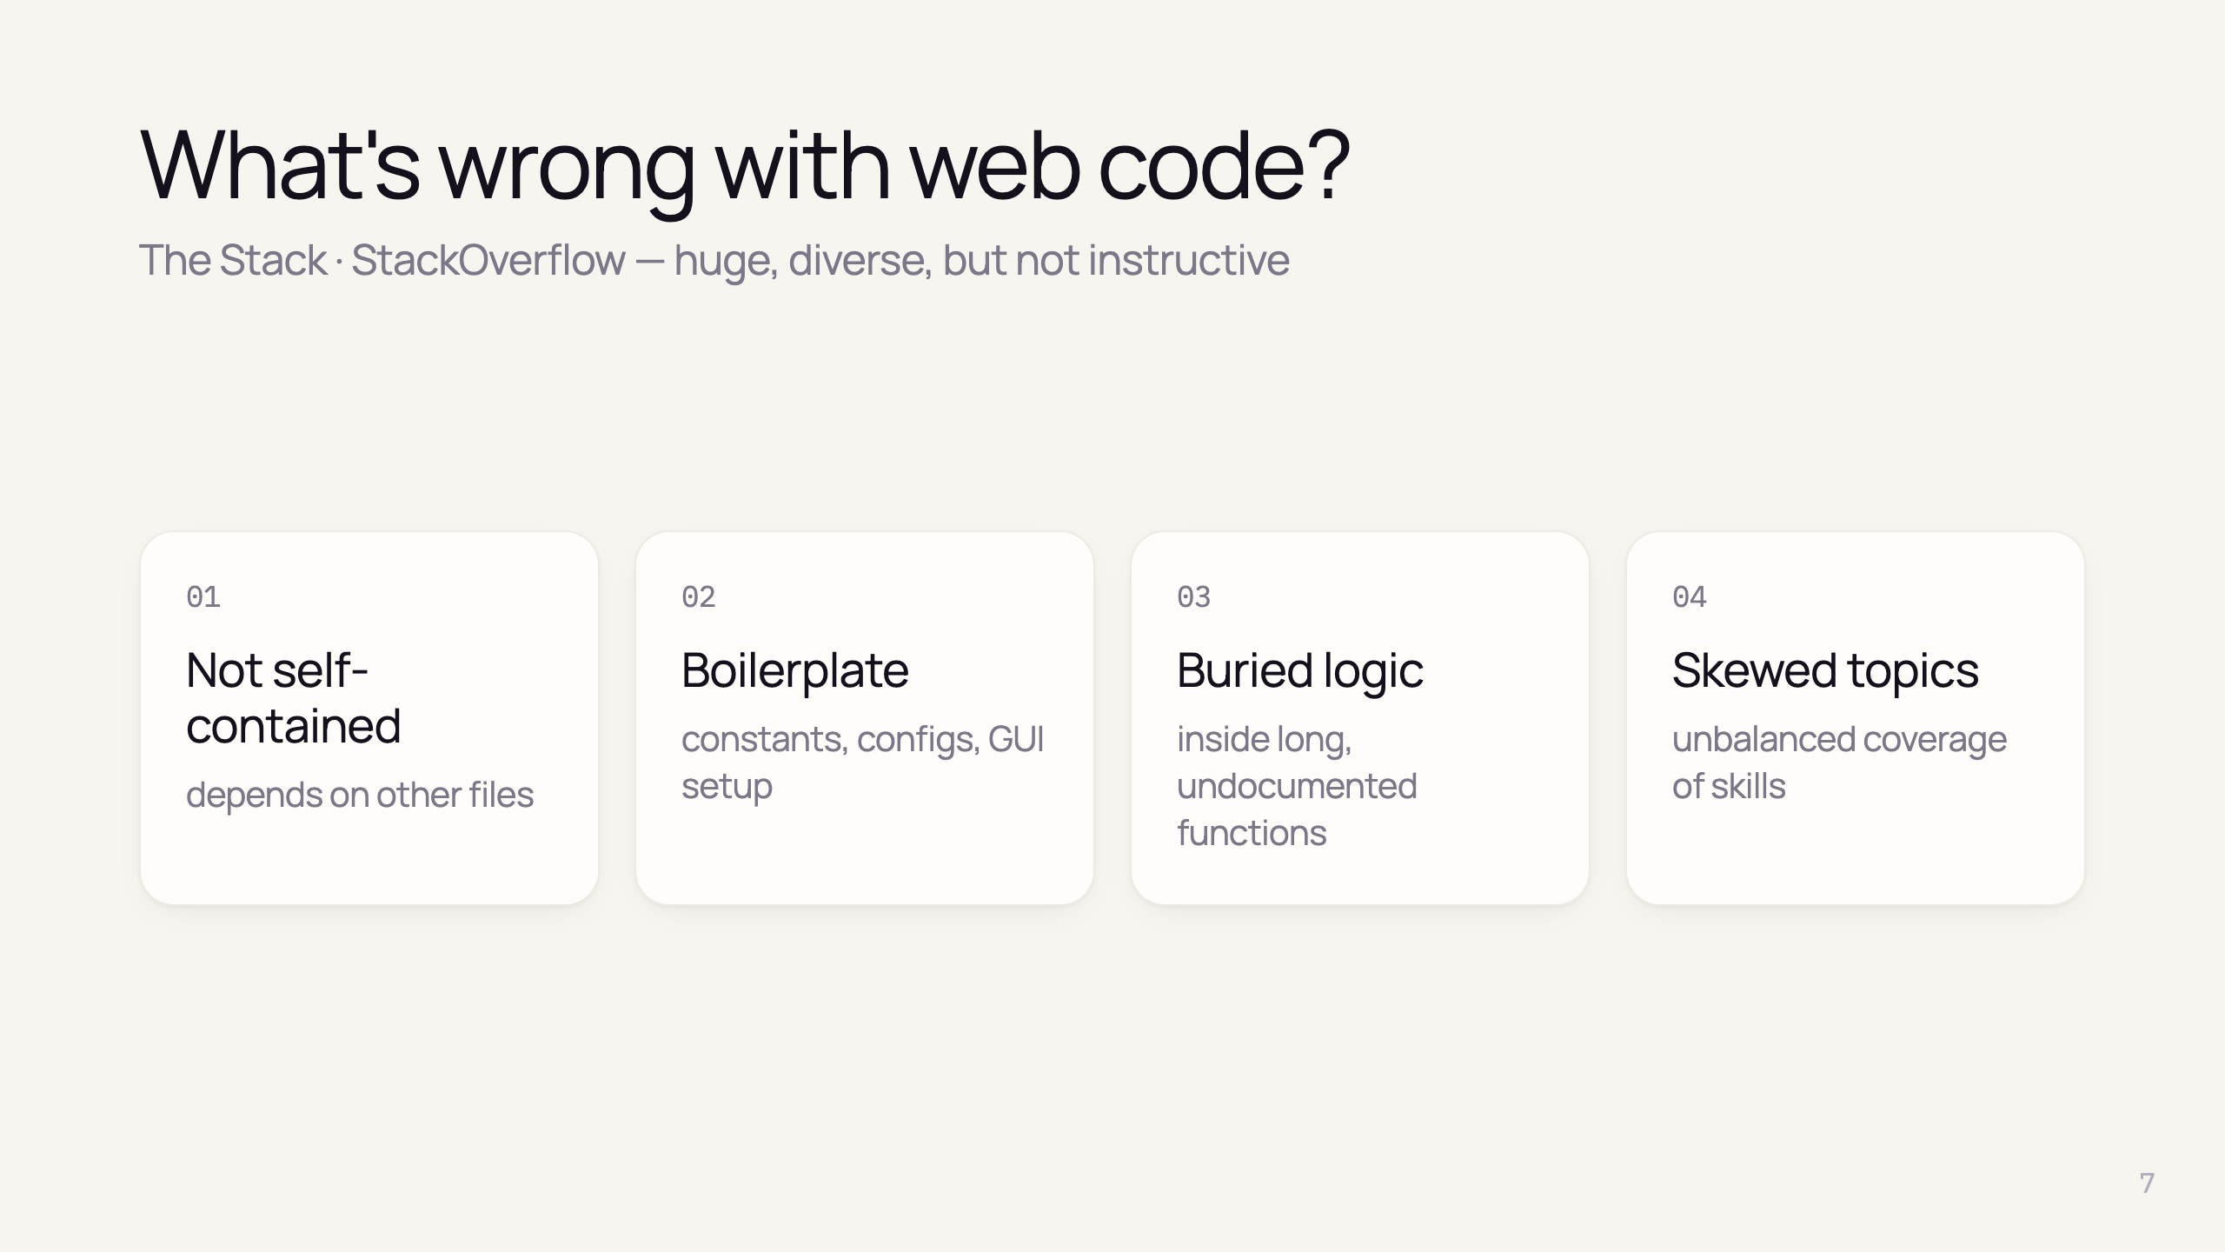
Notes:
- Standard datasets: The Stack (permissive GitHub code), StackOverflow, CodeContests
- Authors manually inspected random samples
- 1: imports from other modules, missing context
- 2: no real logic
- 3: algorithms hidden, poorly documented
- 4: some topics overrepresented
- Human analogy: frustrating to learn coding from noise → same for LMs

Slide 9
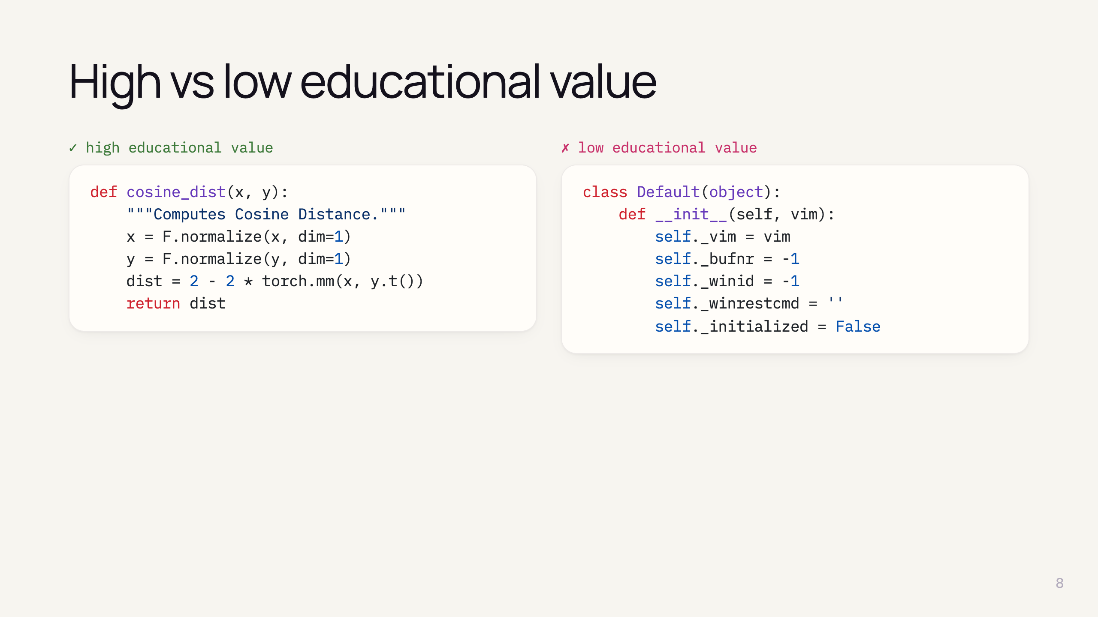
Notes:
- Real examples from the paper
- Left: docstring, real computation, self-contained
- Right: only state initialisation, no logic

Slide 10
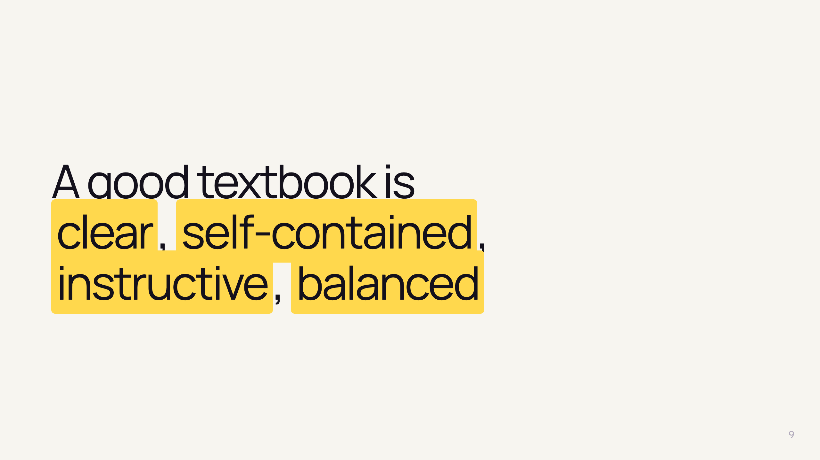
Notes:
- The four qualities the authors want
- Directly opposite of the four problems
- Title of the paper comes from this idea
- Next: how they build such data (core of the paper)

Slide 11
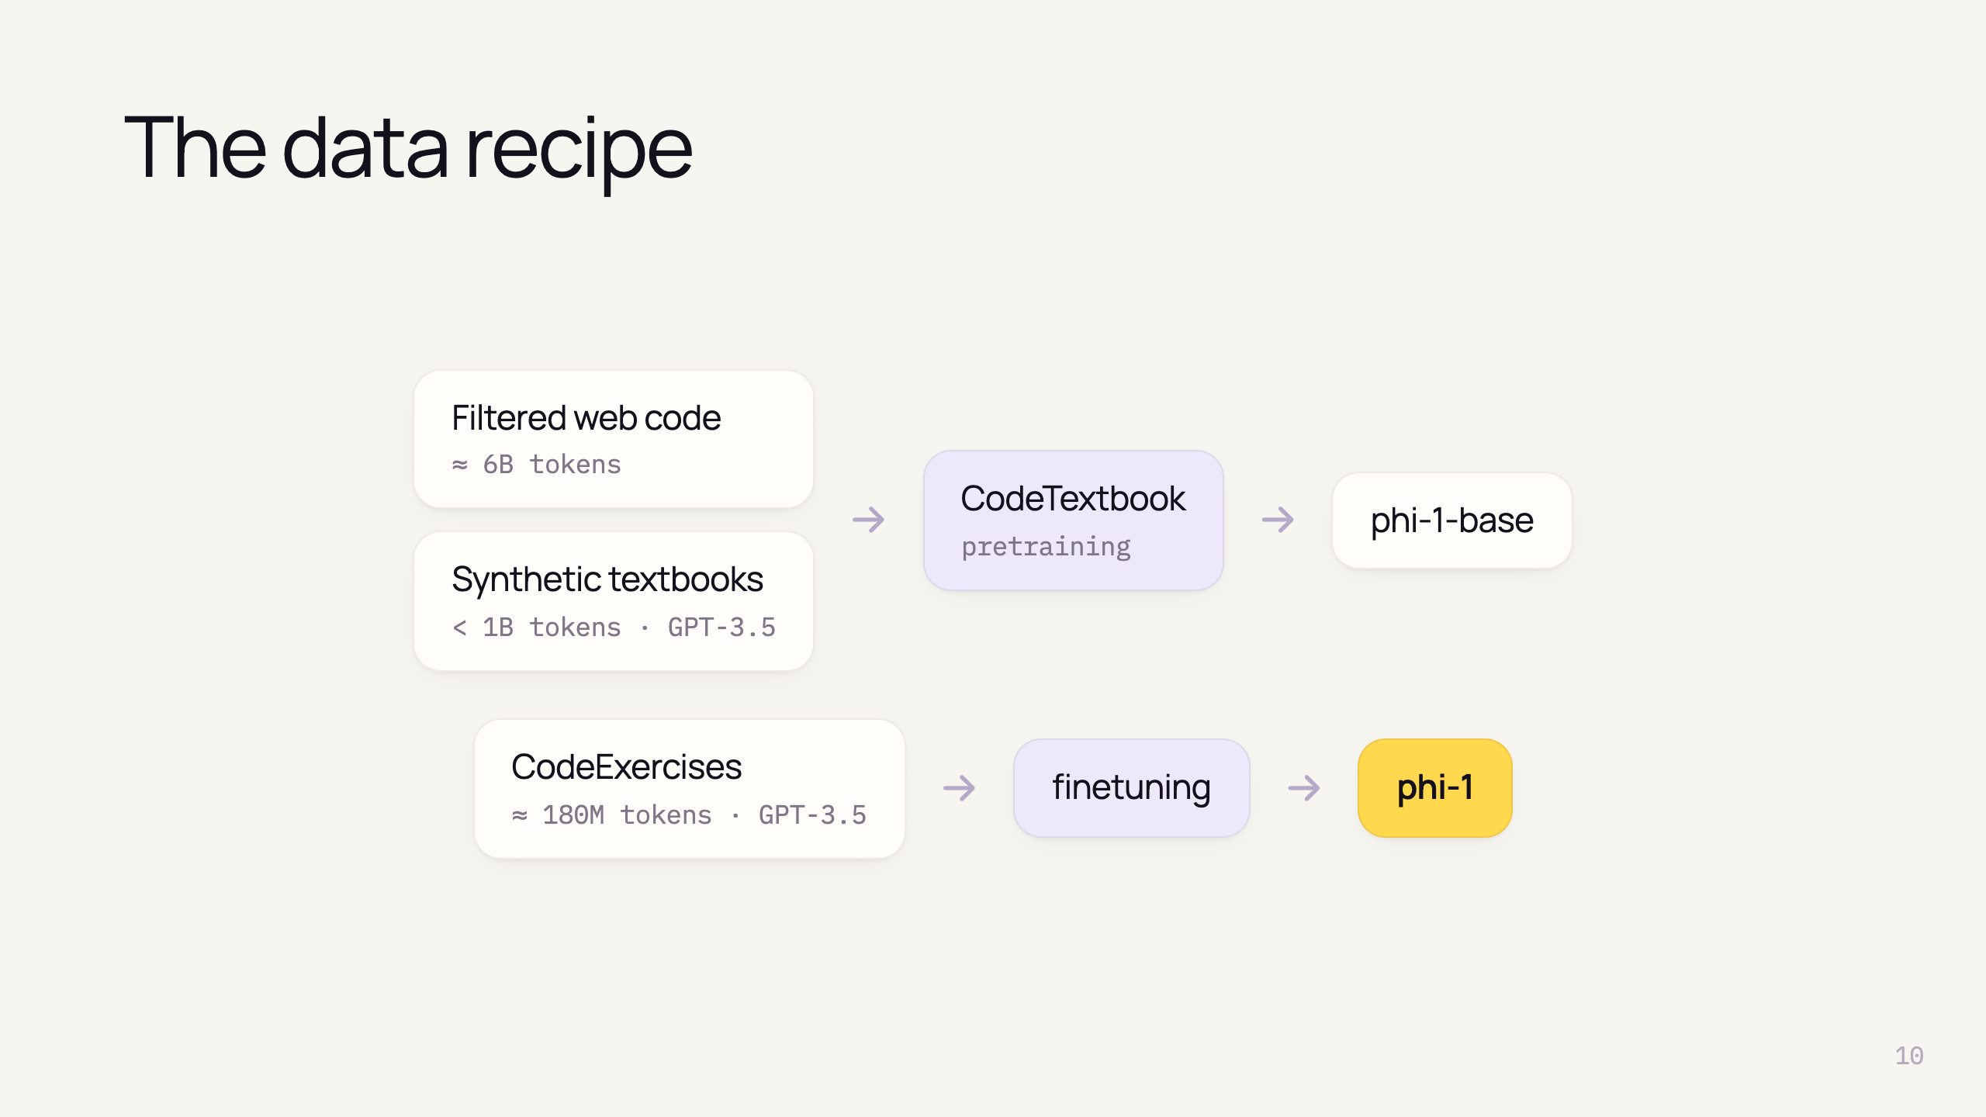
Notes:
- Three datasets, total < 7B tokens
- Pretraining = CodeTextbook = filtered web + synthetic textbooks → phi-1-base (29% HumanEval)
- Finetune on small CodeExercises → phi-1
- Architecture is boring on purpose — data is the contribution

Slide 12
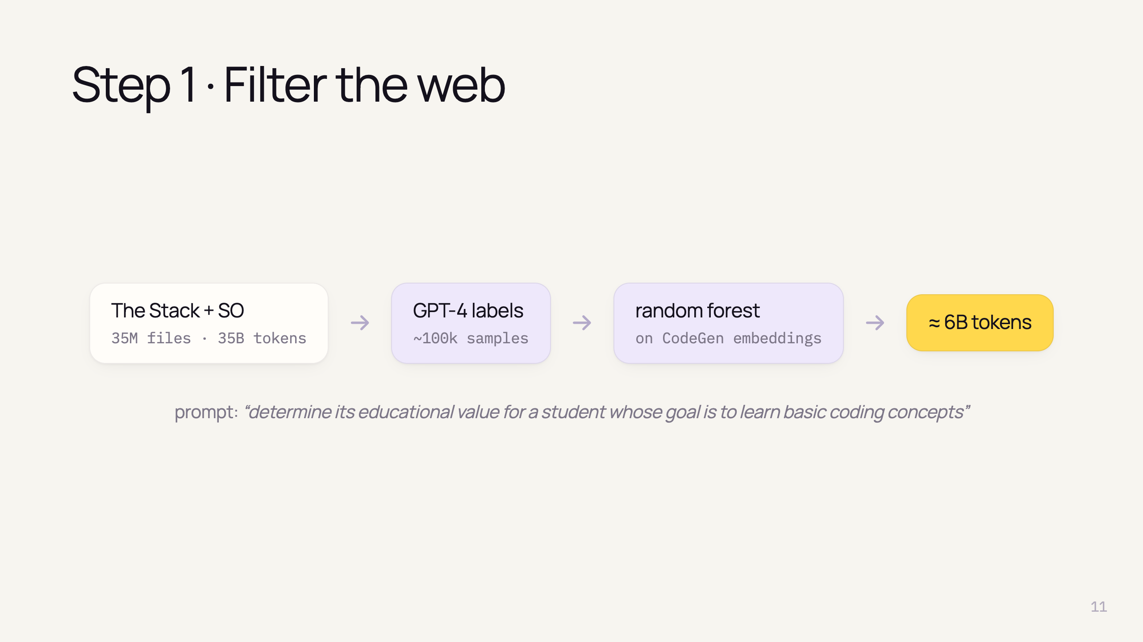
Notes:
- Python subset of deduplicated Stack + StackOverflow
- GPT-4 annotates only a small subset — replaces human labelers (its expensive)
- Classifier: random forest on embeddings from pretrained CodeGen
- Cheap to apply classifier to all 35M files → keep ~6B of 35B tokens

Slide 13
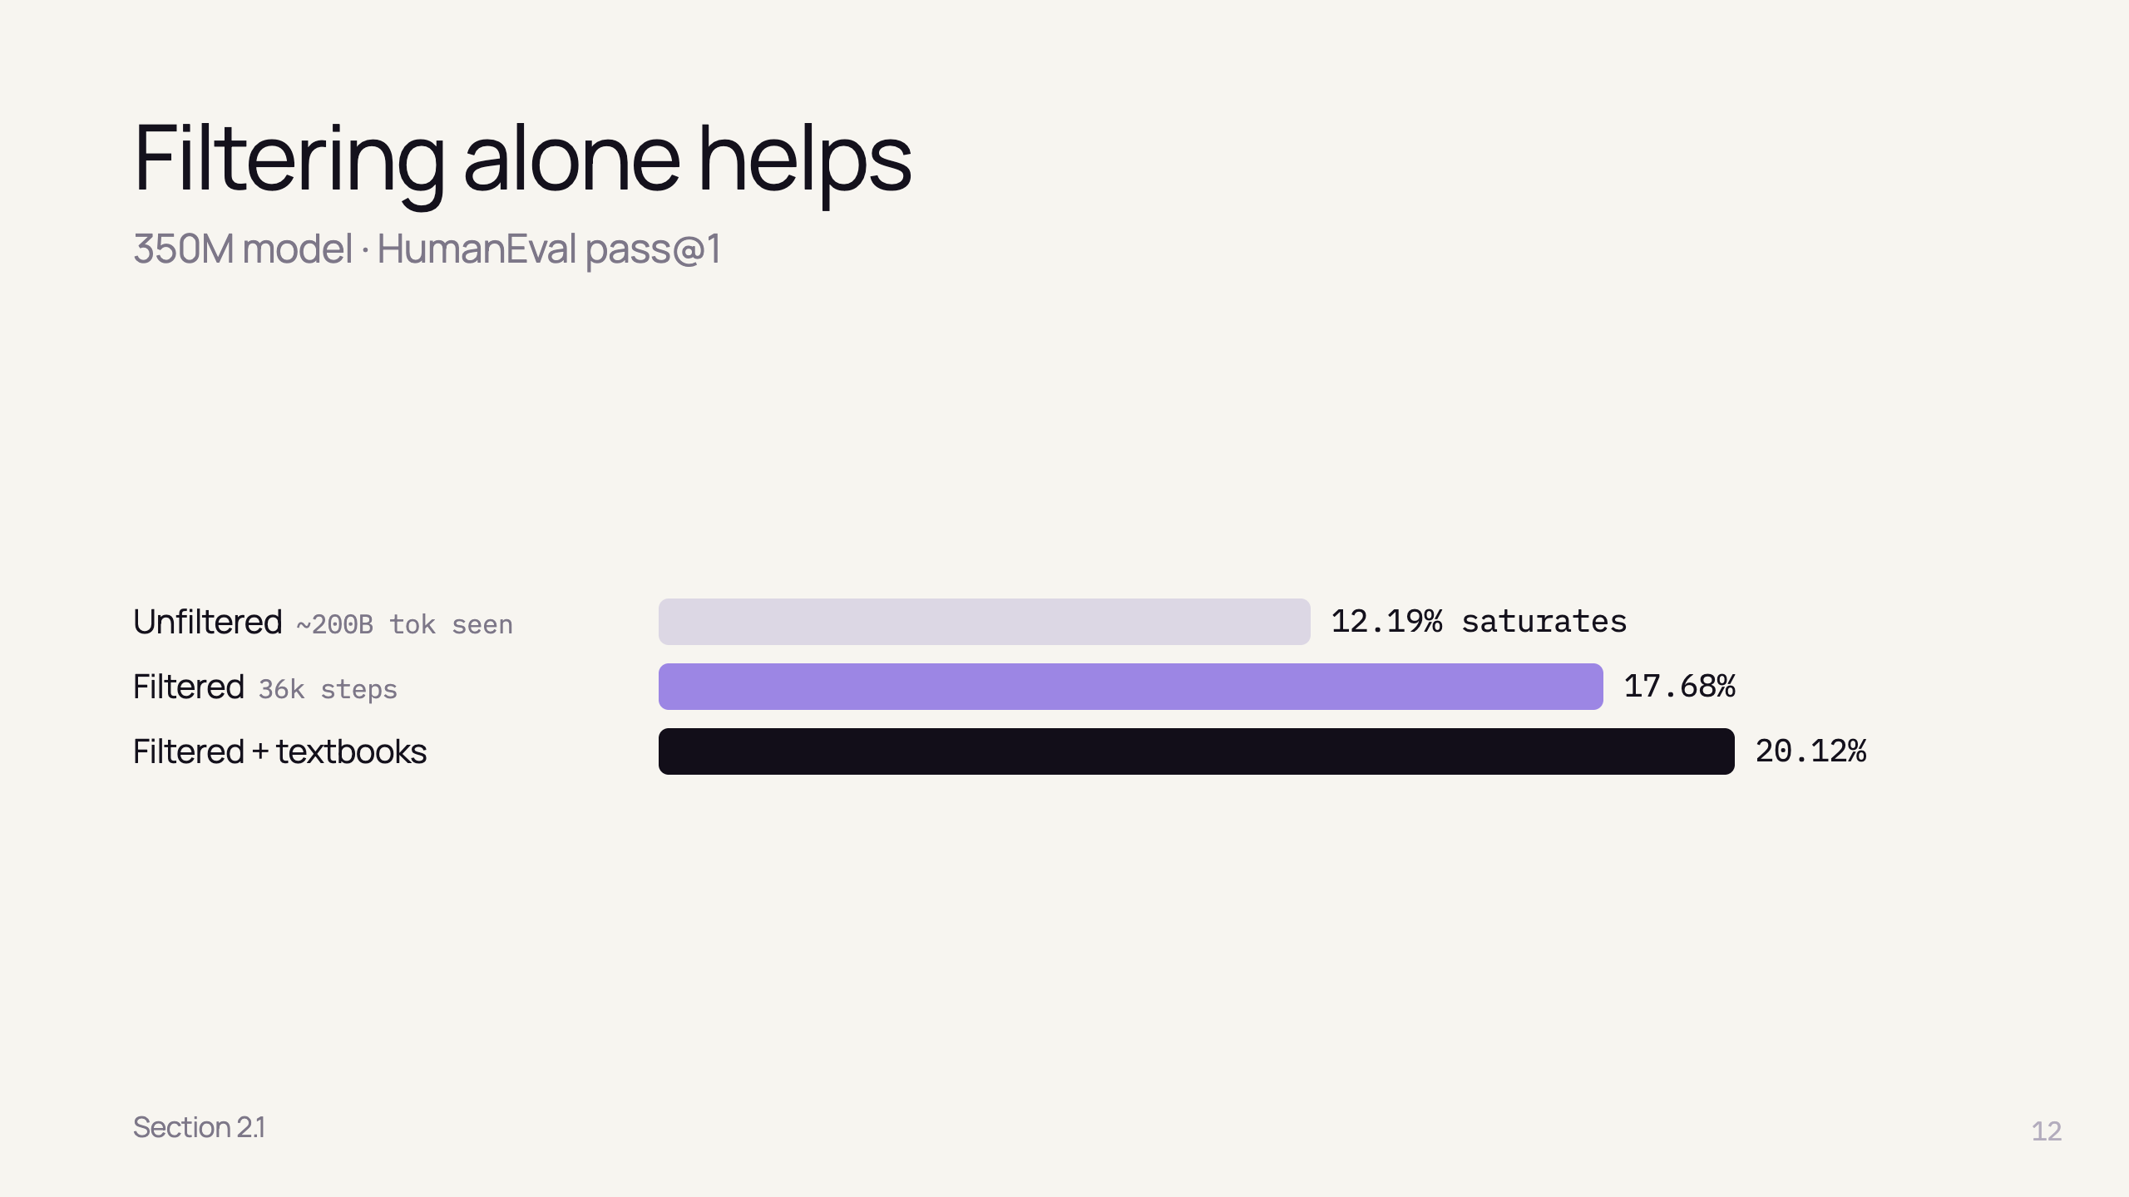
Notes:
- Unfiltered plateaus at 12.19% even after 96k steps (~200B tokens)
- Filtered subset: 17.68% after only 36k steps
- Adding synthetic textbooks: 20.12%
- Less data, better model

Slide 14
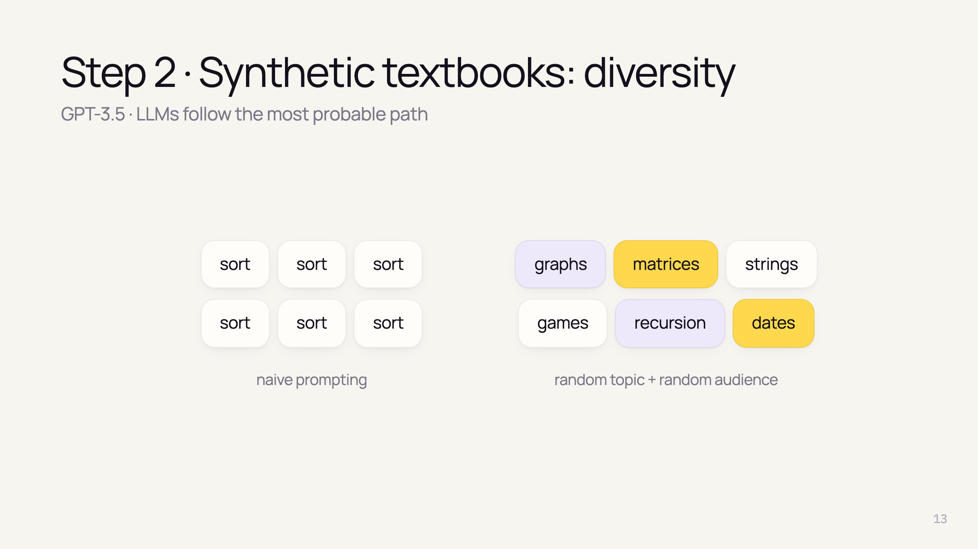
Notes:
- Problem: "write a coding textbook" many times → same content repeated
- Trick: inject randomness — constraints on topic and target audience in each prompt
- TinyStories did the same with random words that must appear

Slide 15
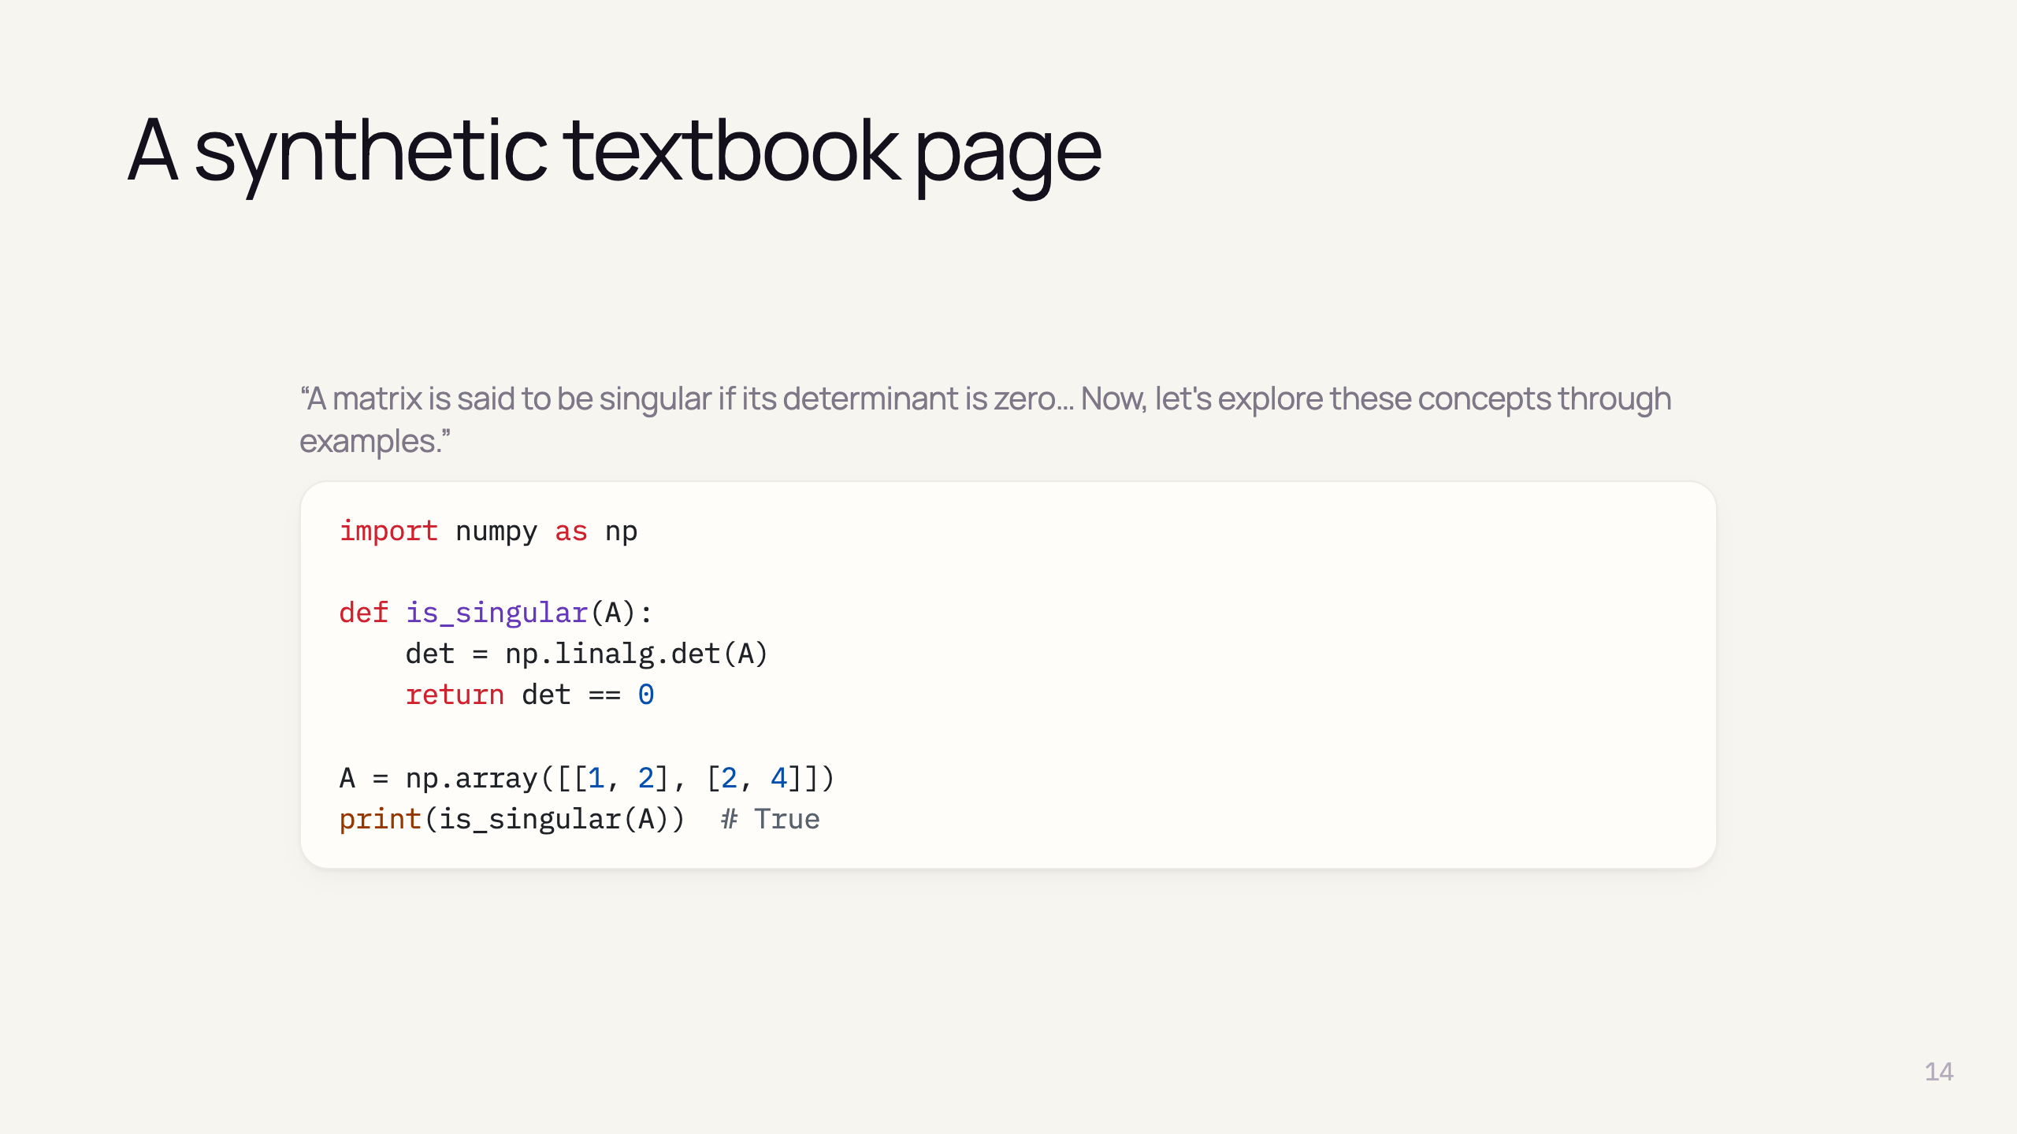
Notes:
- Real sample from the paper (shortened)
- Note: float == 0 is fragile — GPT-3.5 data has many errors (authors admit it) authors expect GPT-4 data to be even better

Slide 16
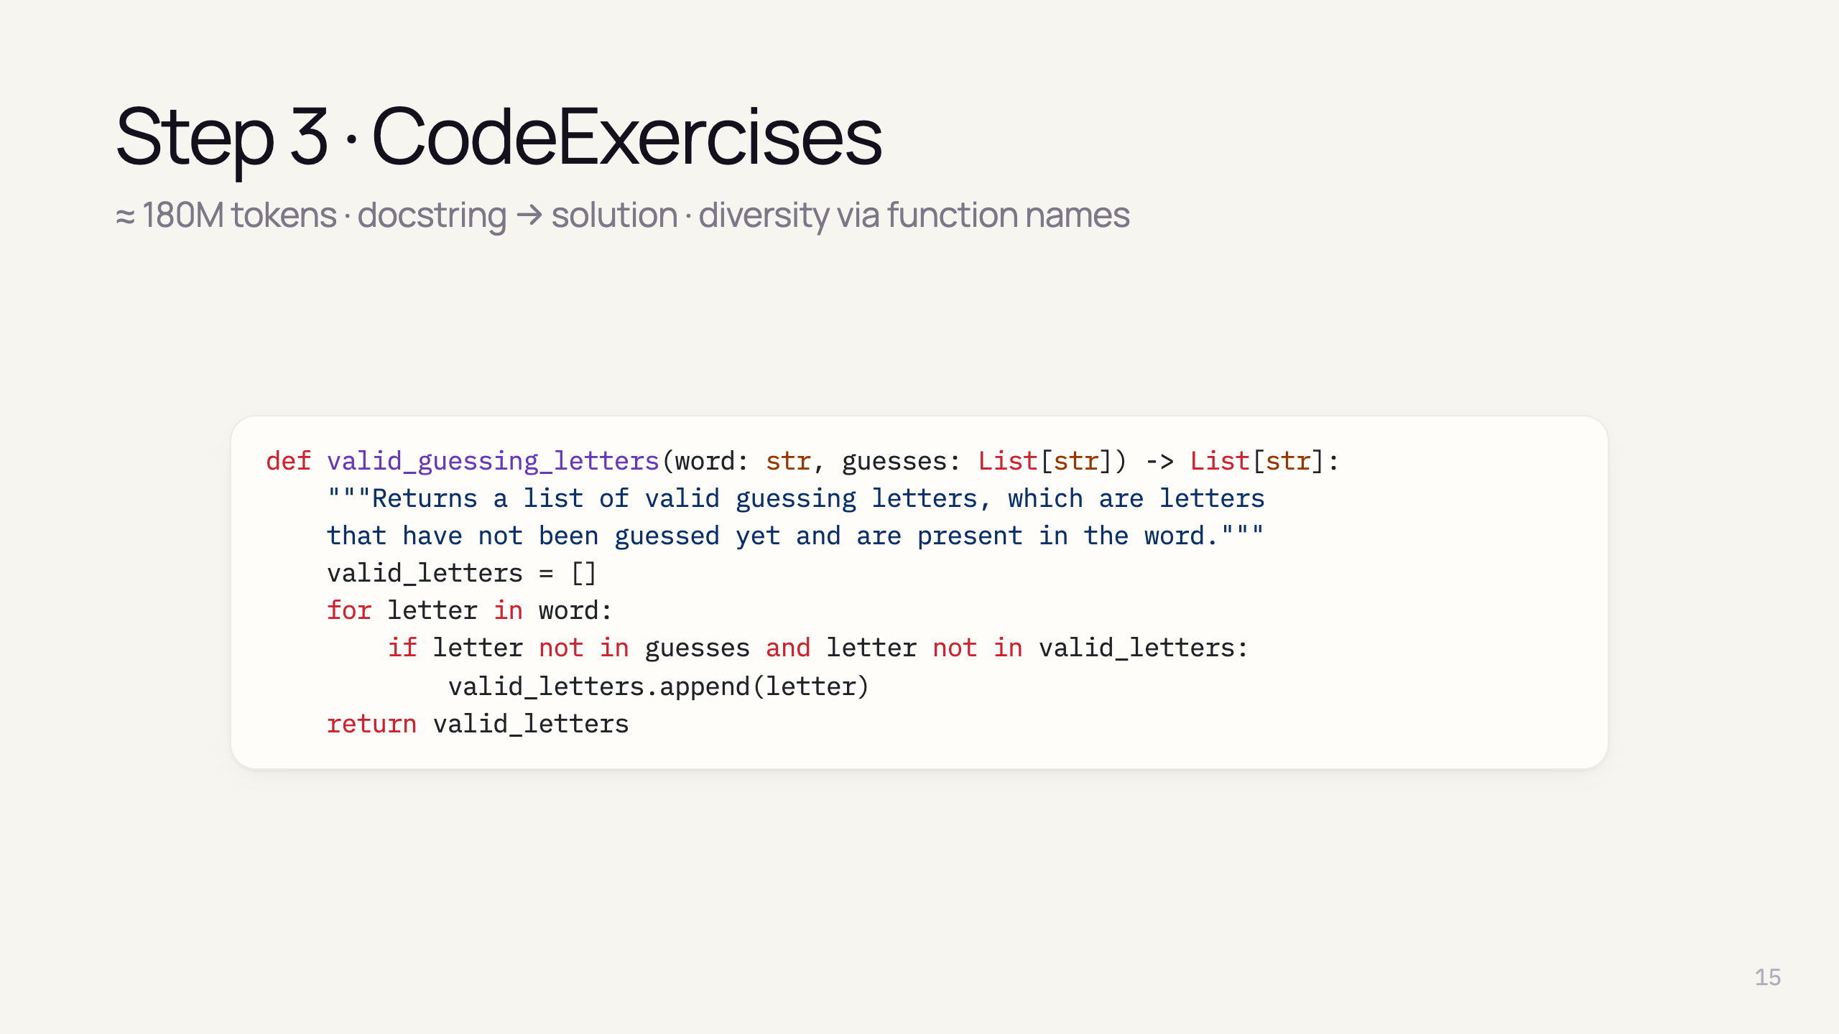
Notes:
- Same format as HumanEval: docstring + function body
- Goal: align model to function completion from instructions
- ~880K exercises, basic libraries only (math, random, typing…)
- Because it looks like HumanEval → contamination checks later

Slide 17
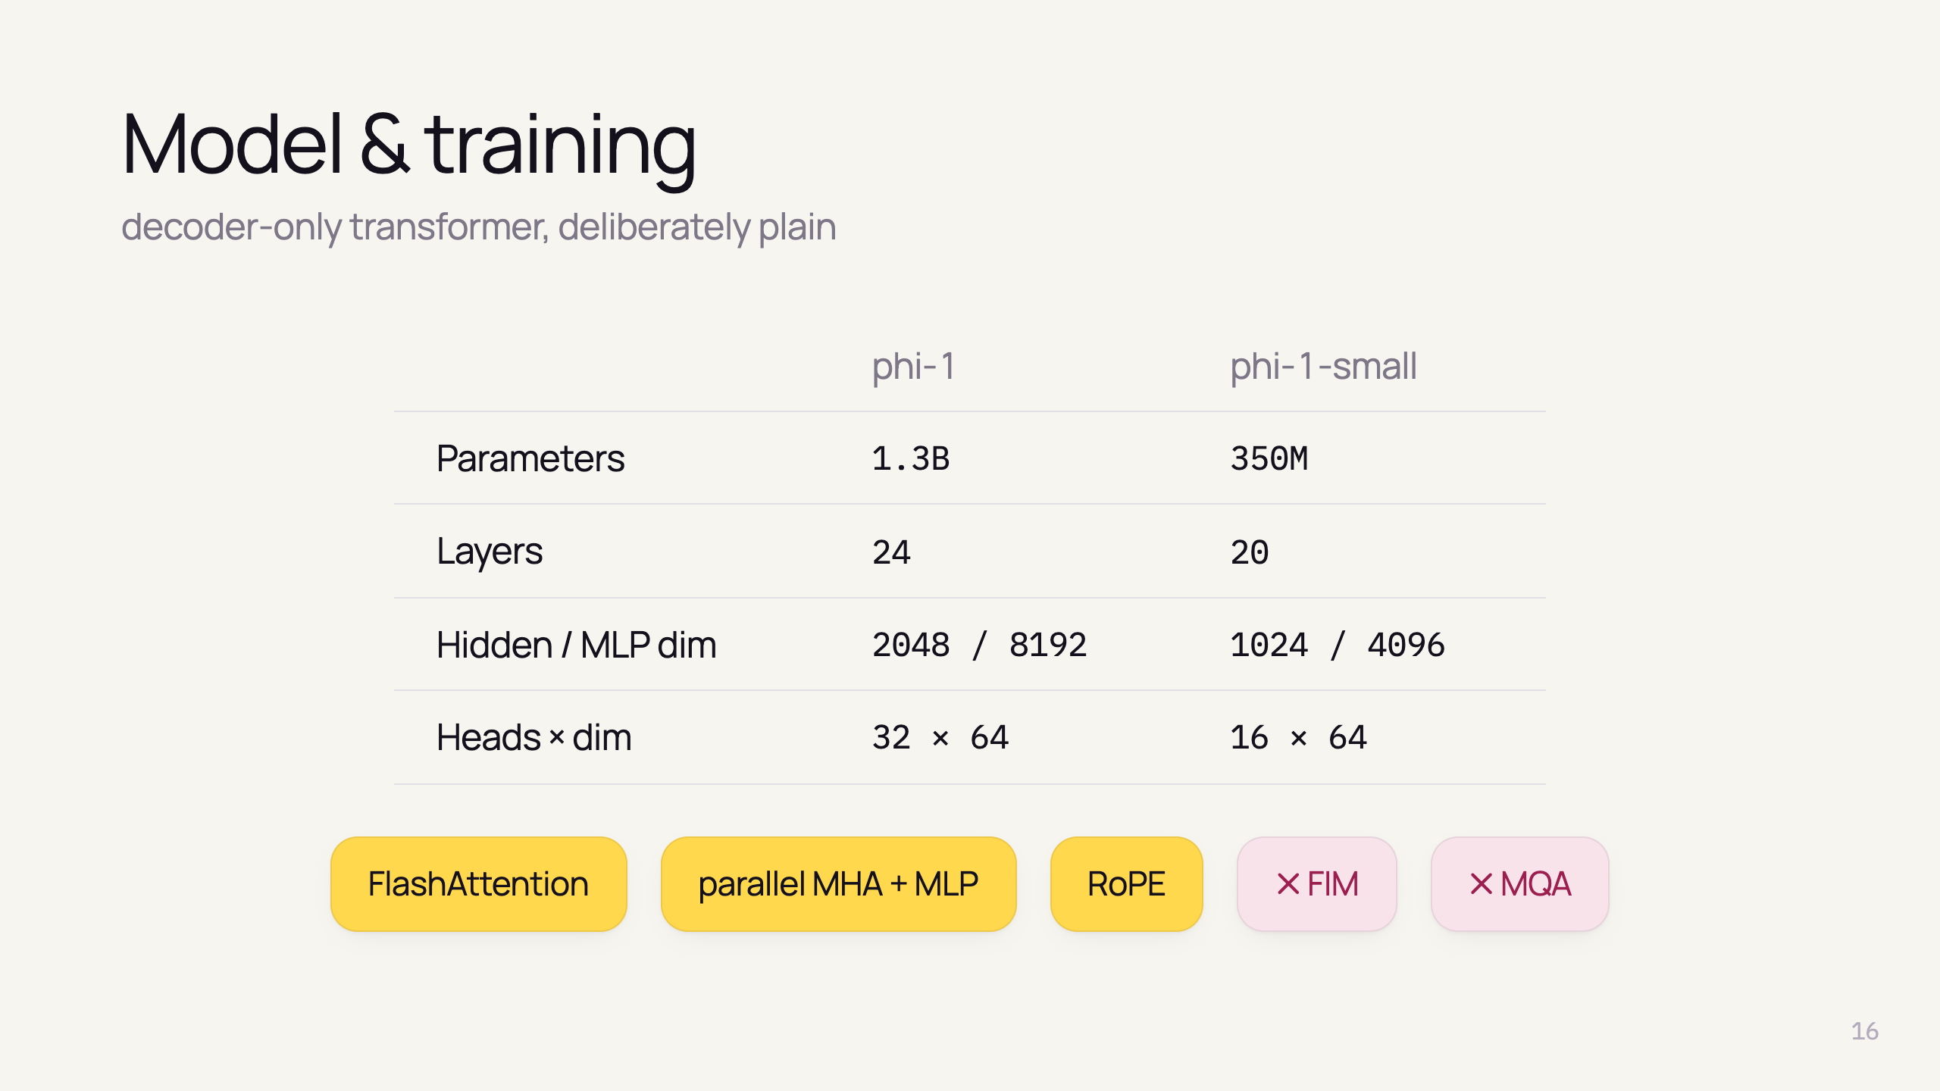
Notes:
- Decoder-only, FlashAttention, parallel attention + MLP (like CodeGen, PaLM), rotary embeddings
- No Fill-In-the-Middle, no Multi-Query Attention — gains come from data, not tricks

Slide 18
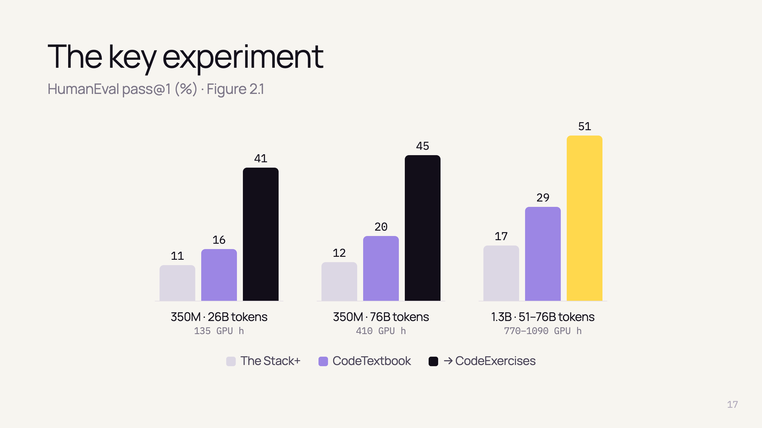
Notes:
- Black/lime: + finetuning — huge jump

Slide 19
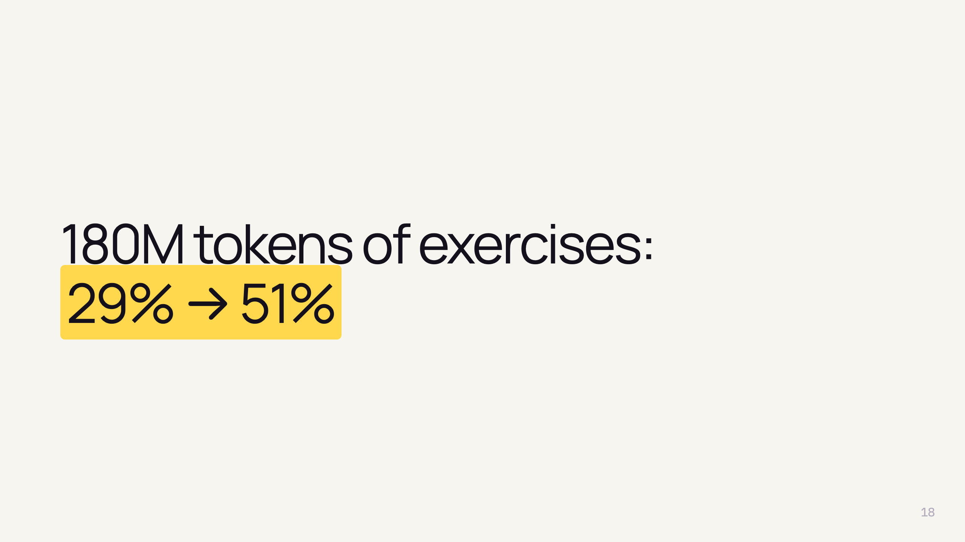
Notes:
- Smallest dataset, biggest jump — < 200M tokens, 7 hours
- Two questions: does finetuning unlock *new* skills? is it just memorization?

Slide 20
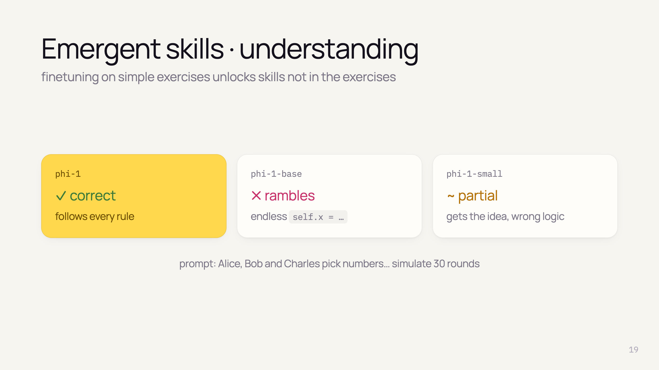
Notes:
- Hypothesis: finetuning "reorganizes" knowledge learned in pretraining
- Prompt with nested ranges and divisibility rule
- phi-1: correct loop and condition
- base: defines attributes, never solves
- small (350M): understands somewhat, but wrong ranges

Slide 21
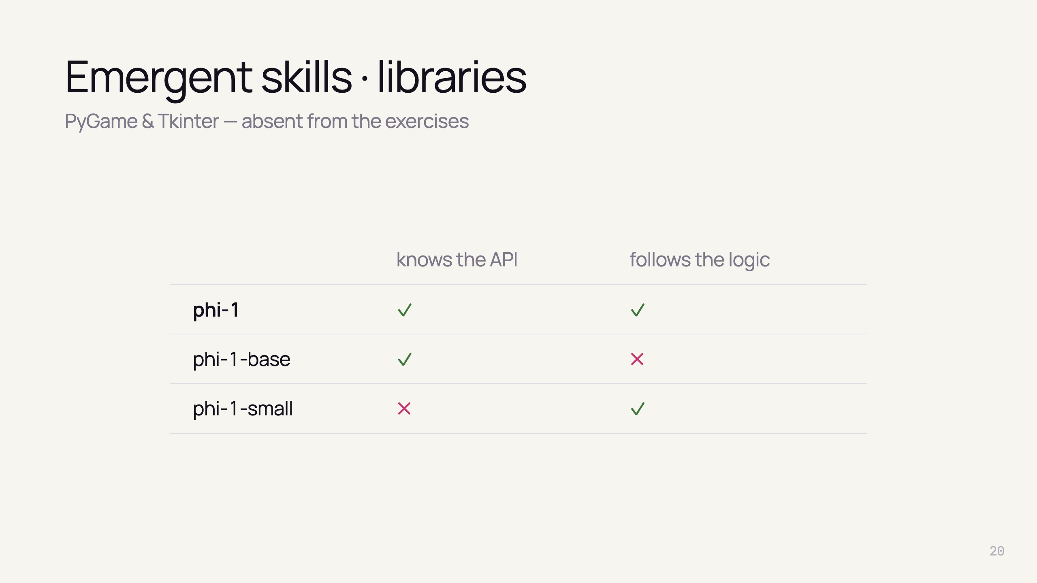
Notes:
- Exercises use only basic libraries — no pygame, no tkinter
- PyGame (bouncing ball): base knows calls but ignores task; small gets logic but lacks API
- Tkinter (pew button app): phi-1 correct except typo; others invent APIs (tk.popup())
- Also wins on PyTorch

Slide 22
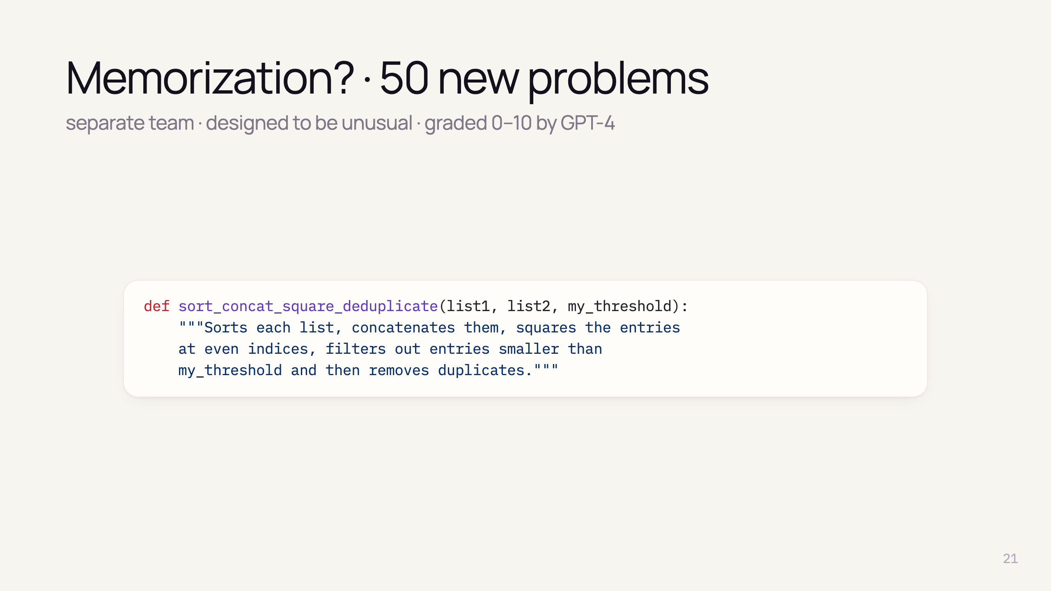
Notes:
- Worry: CodeExercises has the same format as HumanEval → possible leakage
- Three answers: new benchmark, n-gram check, aggressive pruning
- Team had no access to CodeExercises or the model
- Weird combinations of steps → can't be memorized
- GPT-4 as grader: verbal evaluation then 0–10 grade; finer than pass/fail, no tests needed

Slide 23
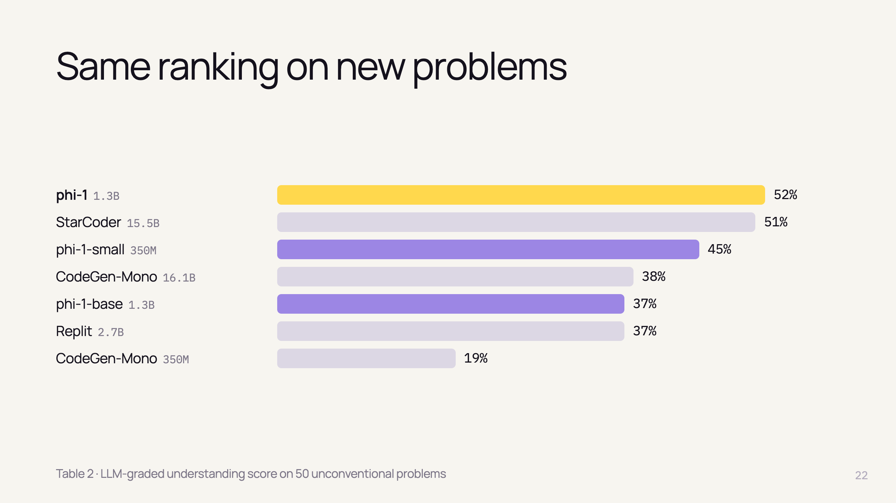
Notes:
- Ranking matches HumanEval
- phi-1 52% vs StarCoder 51% — closer here (HumanEval: 51 vs 34)
- phi-1-small (350M) 45% — beats 16B CodeGen

Slide 24
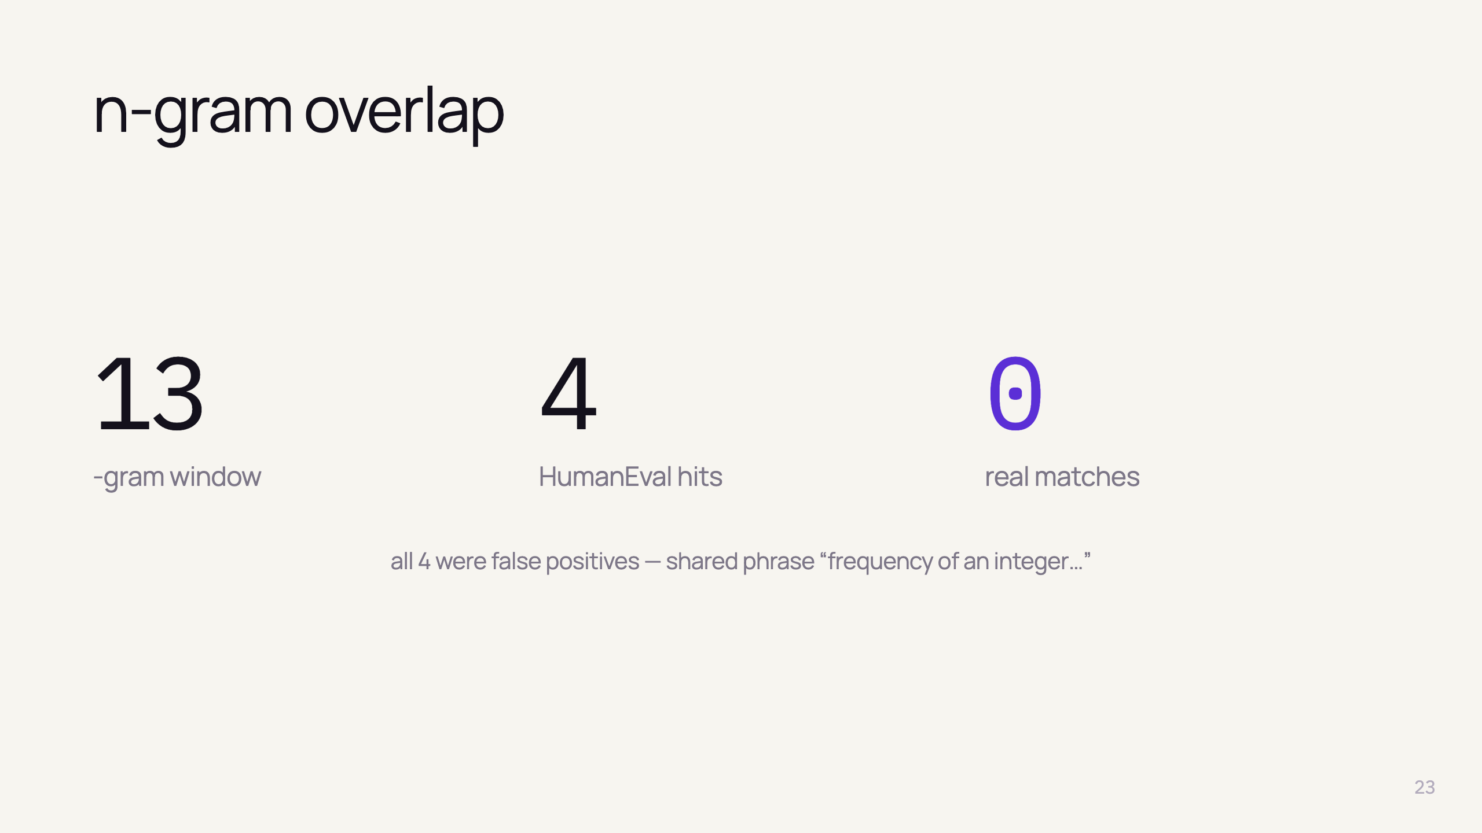
Notes:
- Standard contamination check
- Only 4 hits, all false positives (same generic sentence)
- But n-grams miss paraphrases → need a stronger test

Slide 25
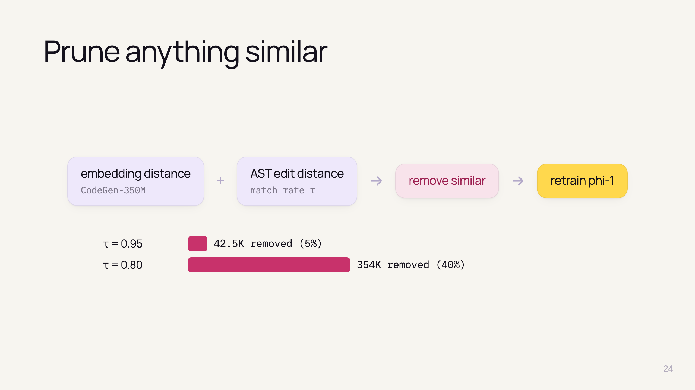
Notes:
- Embeddings: semantic similarity (docstring, names, structure)
- AST distance: structure, ignores names/comments
- "Strong form" of decontamination, retrain from scratch
- Lower τ = looser similarity = more removed; up to 40% of 879.5K exercises

Slide 26
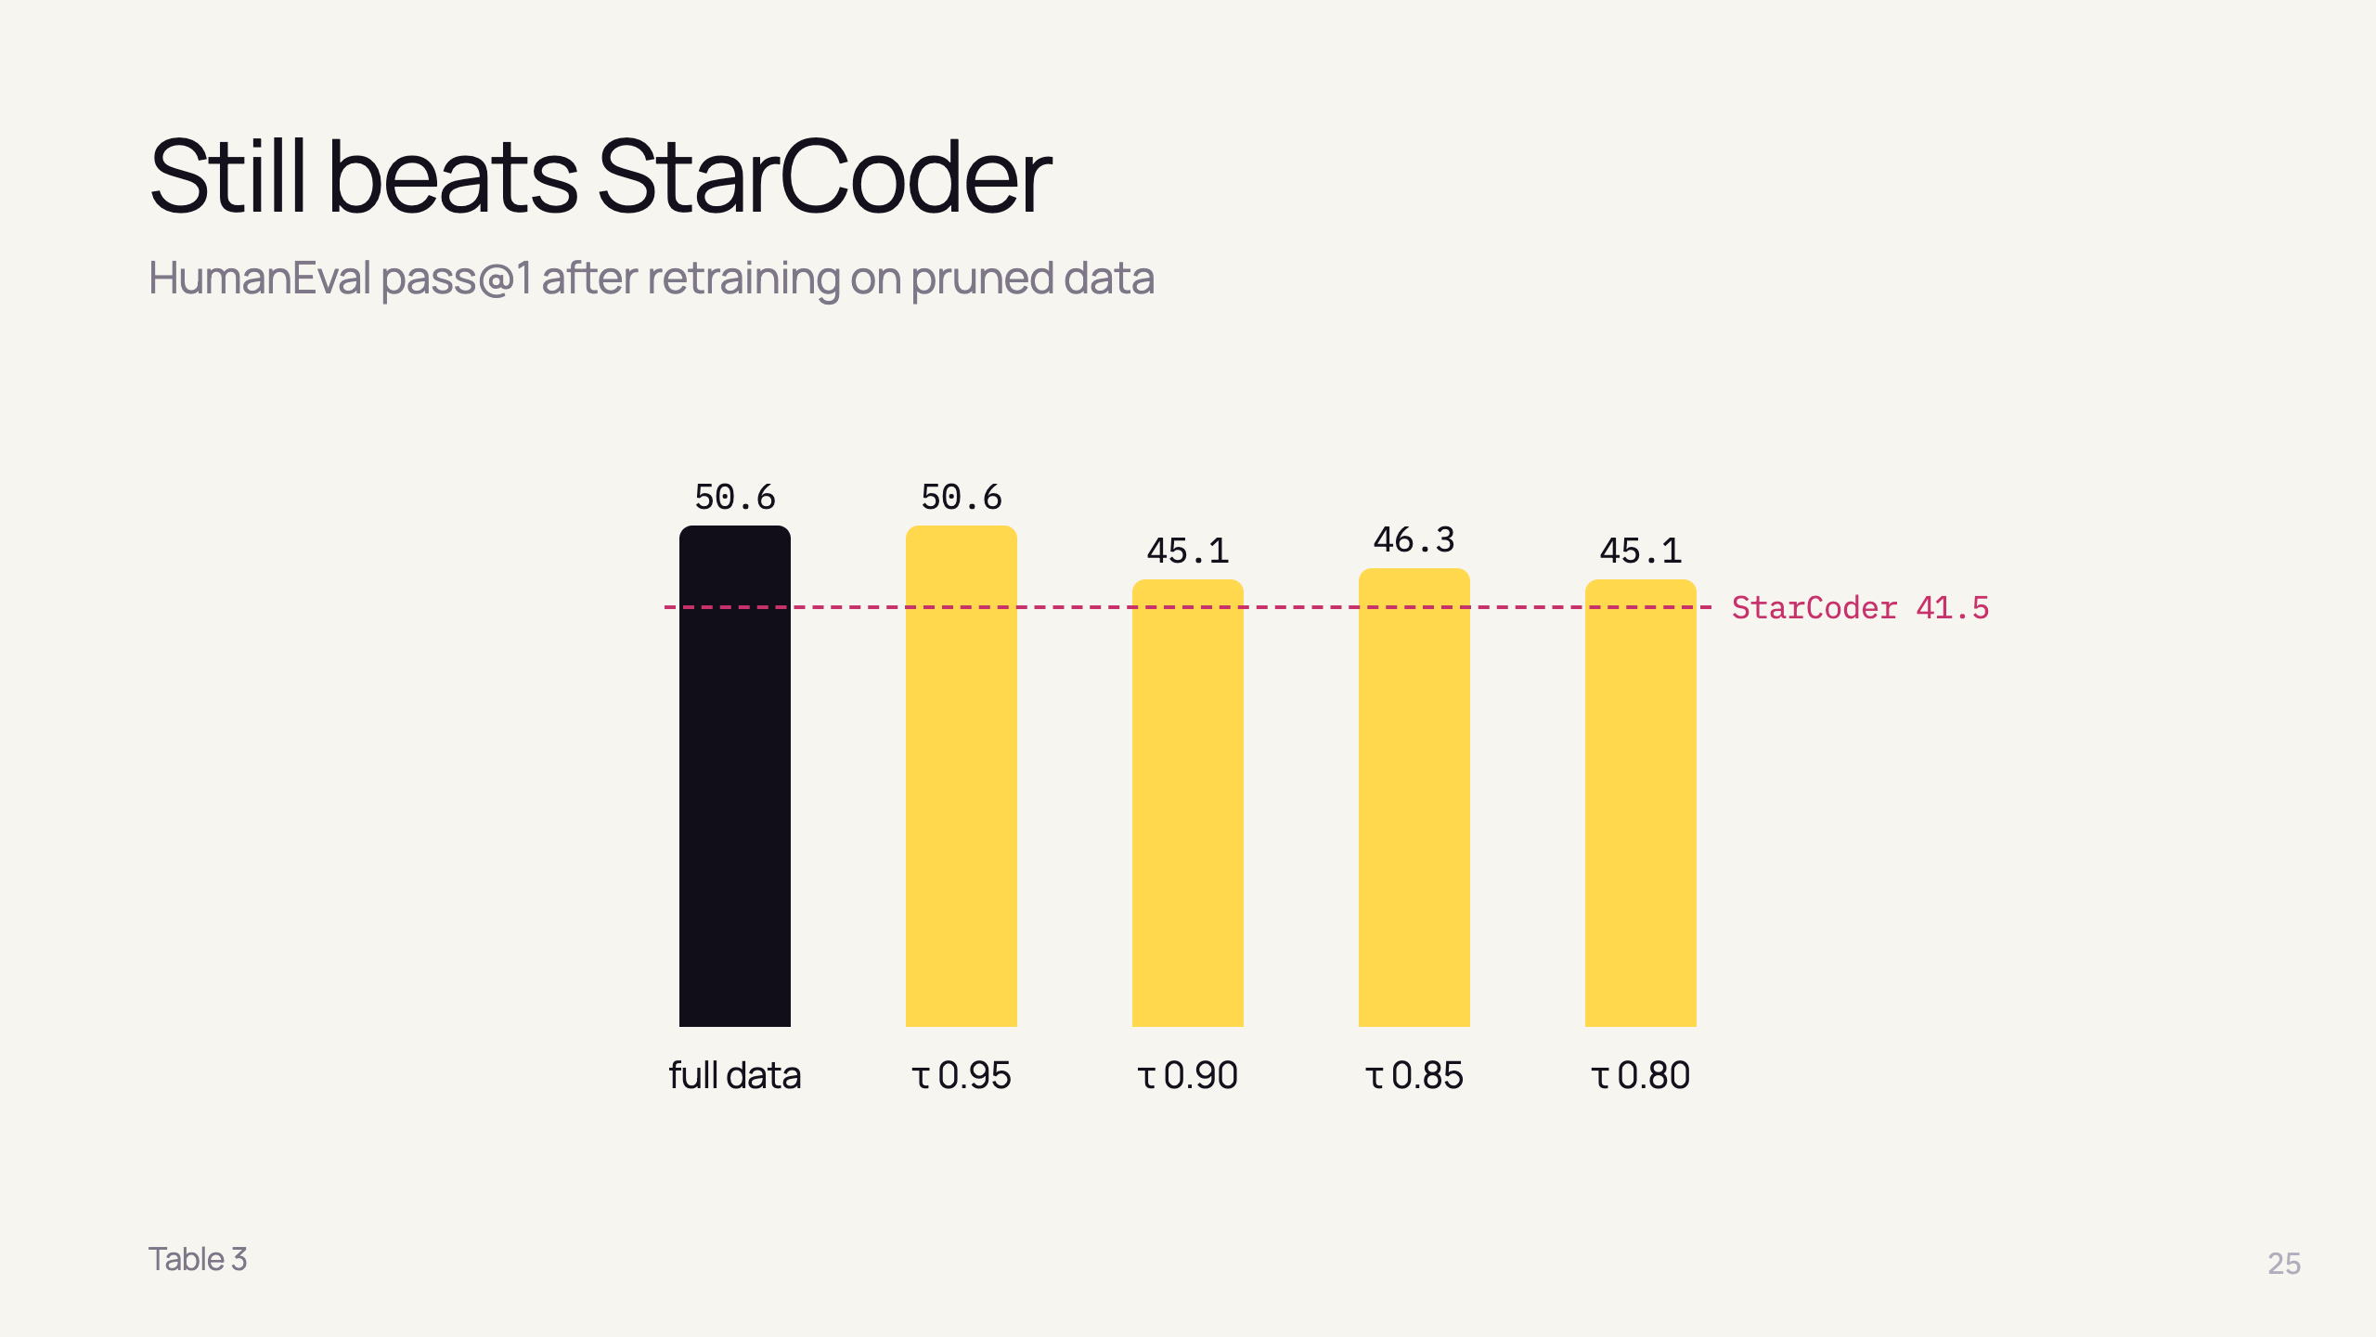
Notes:
- Some drop (50.6 → ~45) — similar data did help a bit
- All models score higher on the "similar" subset → those problems may simply be easier

Slide 27
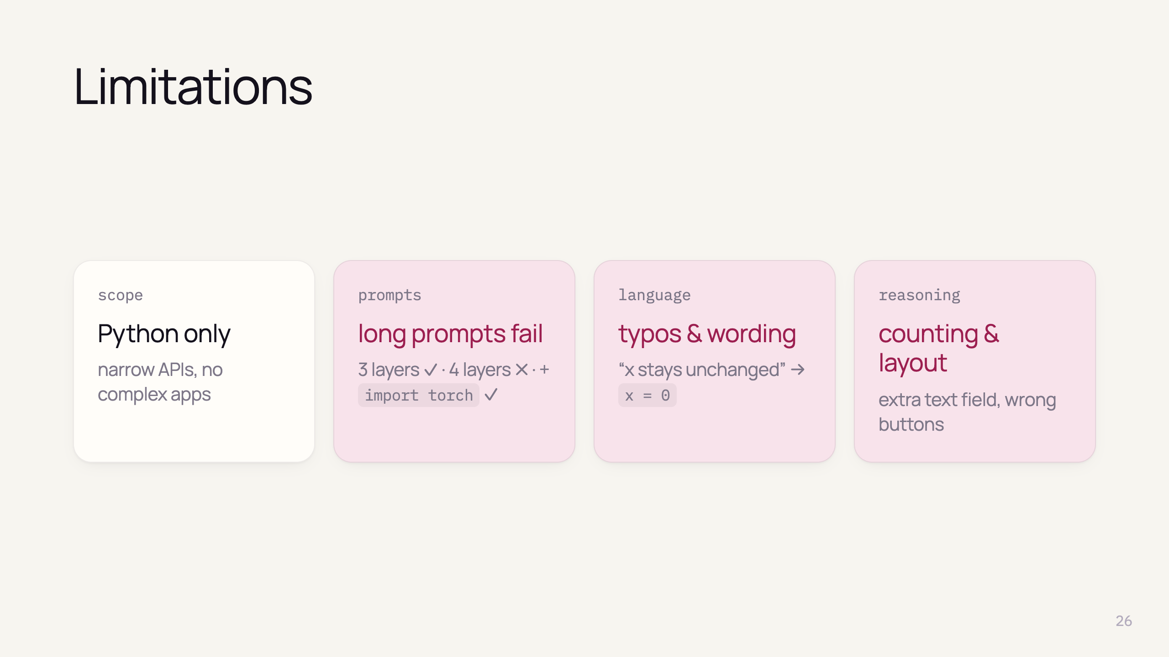
Notes:
- Specialist: Python only, lacks domain knowledge of big models (e.g. Flask apps)
- Exercises are short
- Grammar mistakes
- Trade-off: textbook-clean data vs messy real-world users

Slide 28
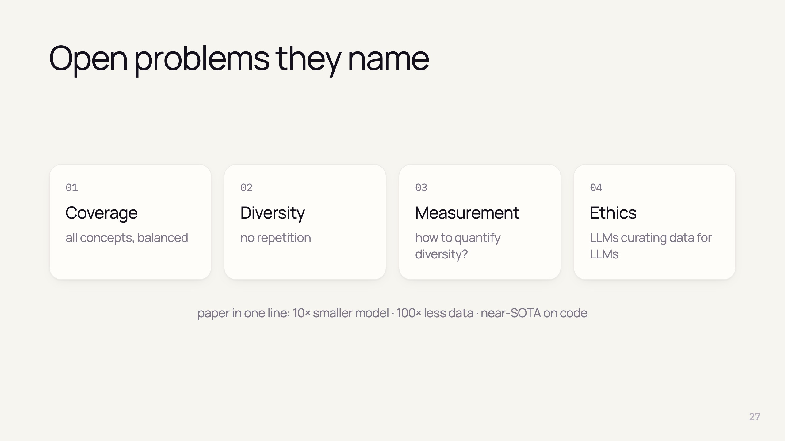
Notes:
- Dataset creation methodology = central research direction
- No good metric for diversity / redundancy
- Accountability, transparency, bias when models train models; "recursive training" debate
- GPT-3.5 data noisy — better teacher should help

Slide 29

Notes:
- From here: knowledge from web sources, not from the paper
- Orange tag on every such slide
- ~10 min: Phi family, impact on the field, state today

Slide 30
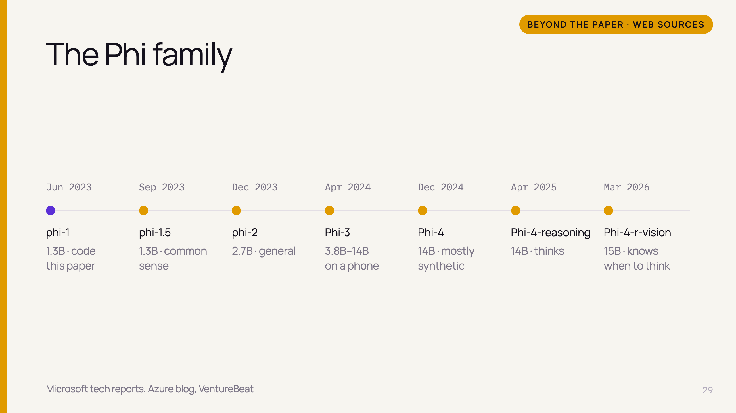
Notes:
- phi-1.5 ("Textbooks Are All You Need II"): same recipe beyond code → common sense
- phi-2: 2.7B, 1.4T tokens; claimed to match models up to 25× larger
- Phi-3-mini 3.8B: 69% MMLU ≈ GPT-3.5, runs on a phone;
- Size grew 1.3B → 15B — still small vs frontier

Slide 31
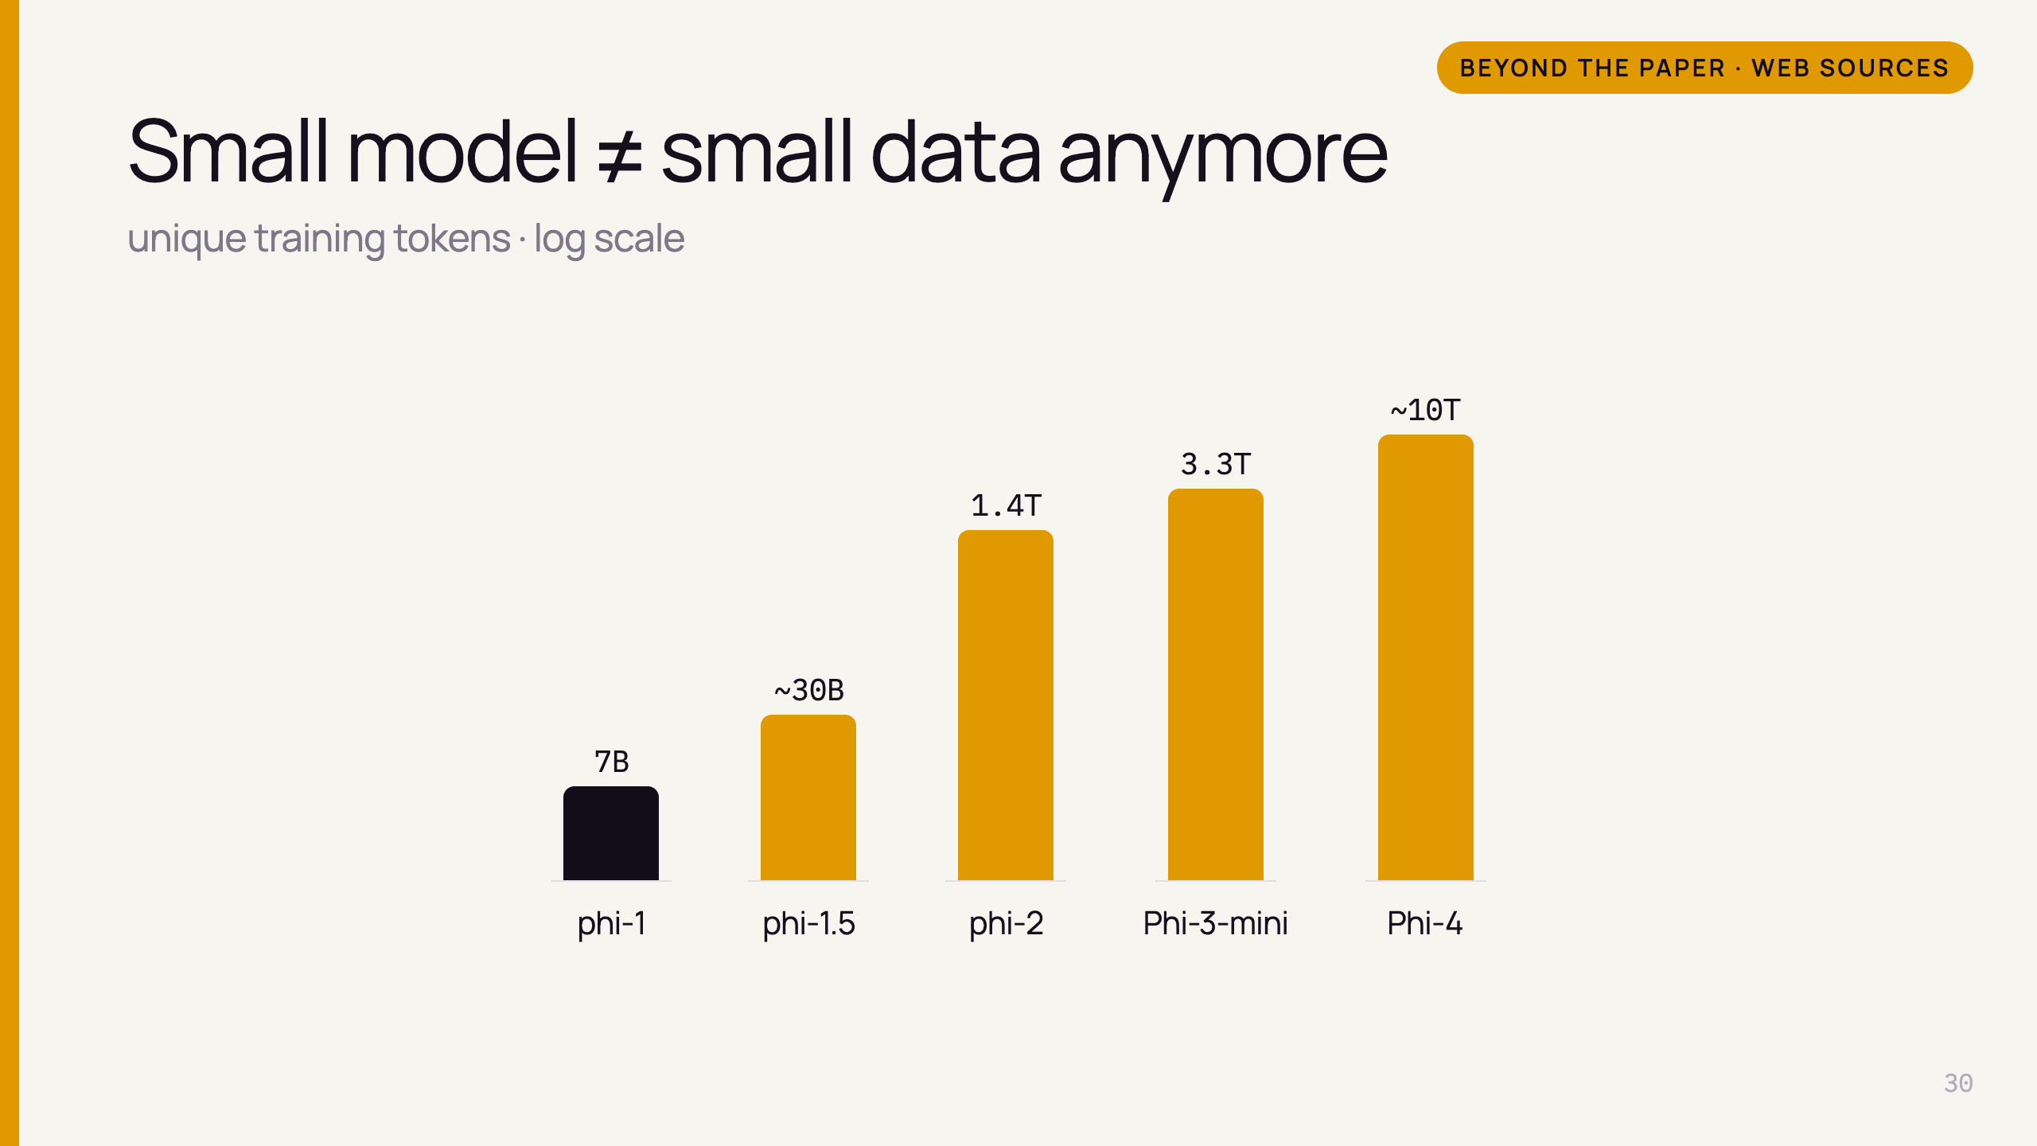
Notes:
- phi-1 was famous for tiny data (7B)
- Later Phi models: trillions of tokens
- "Less data" part did NOT survive; "better data" part did

Slide 32
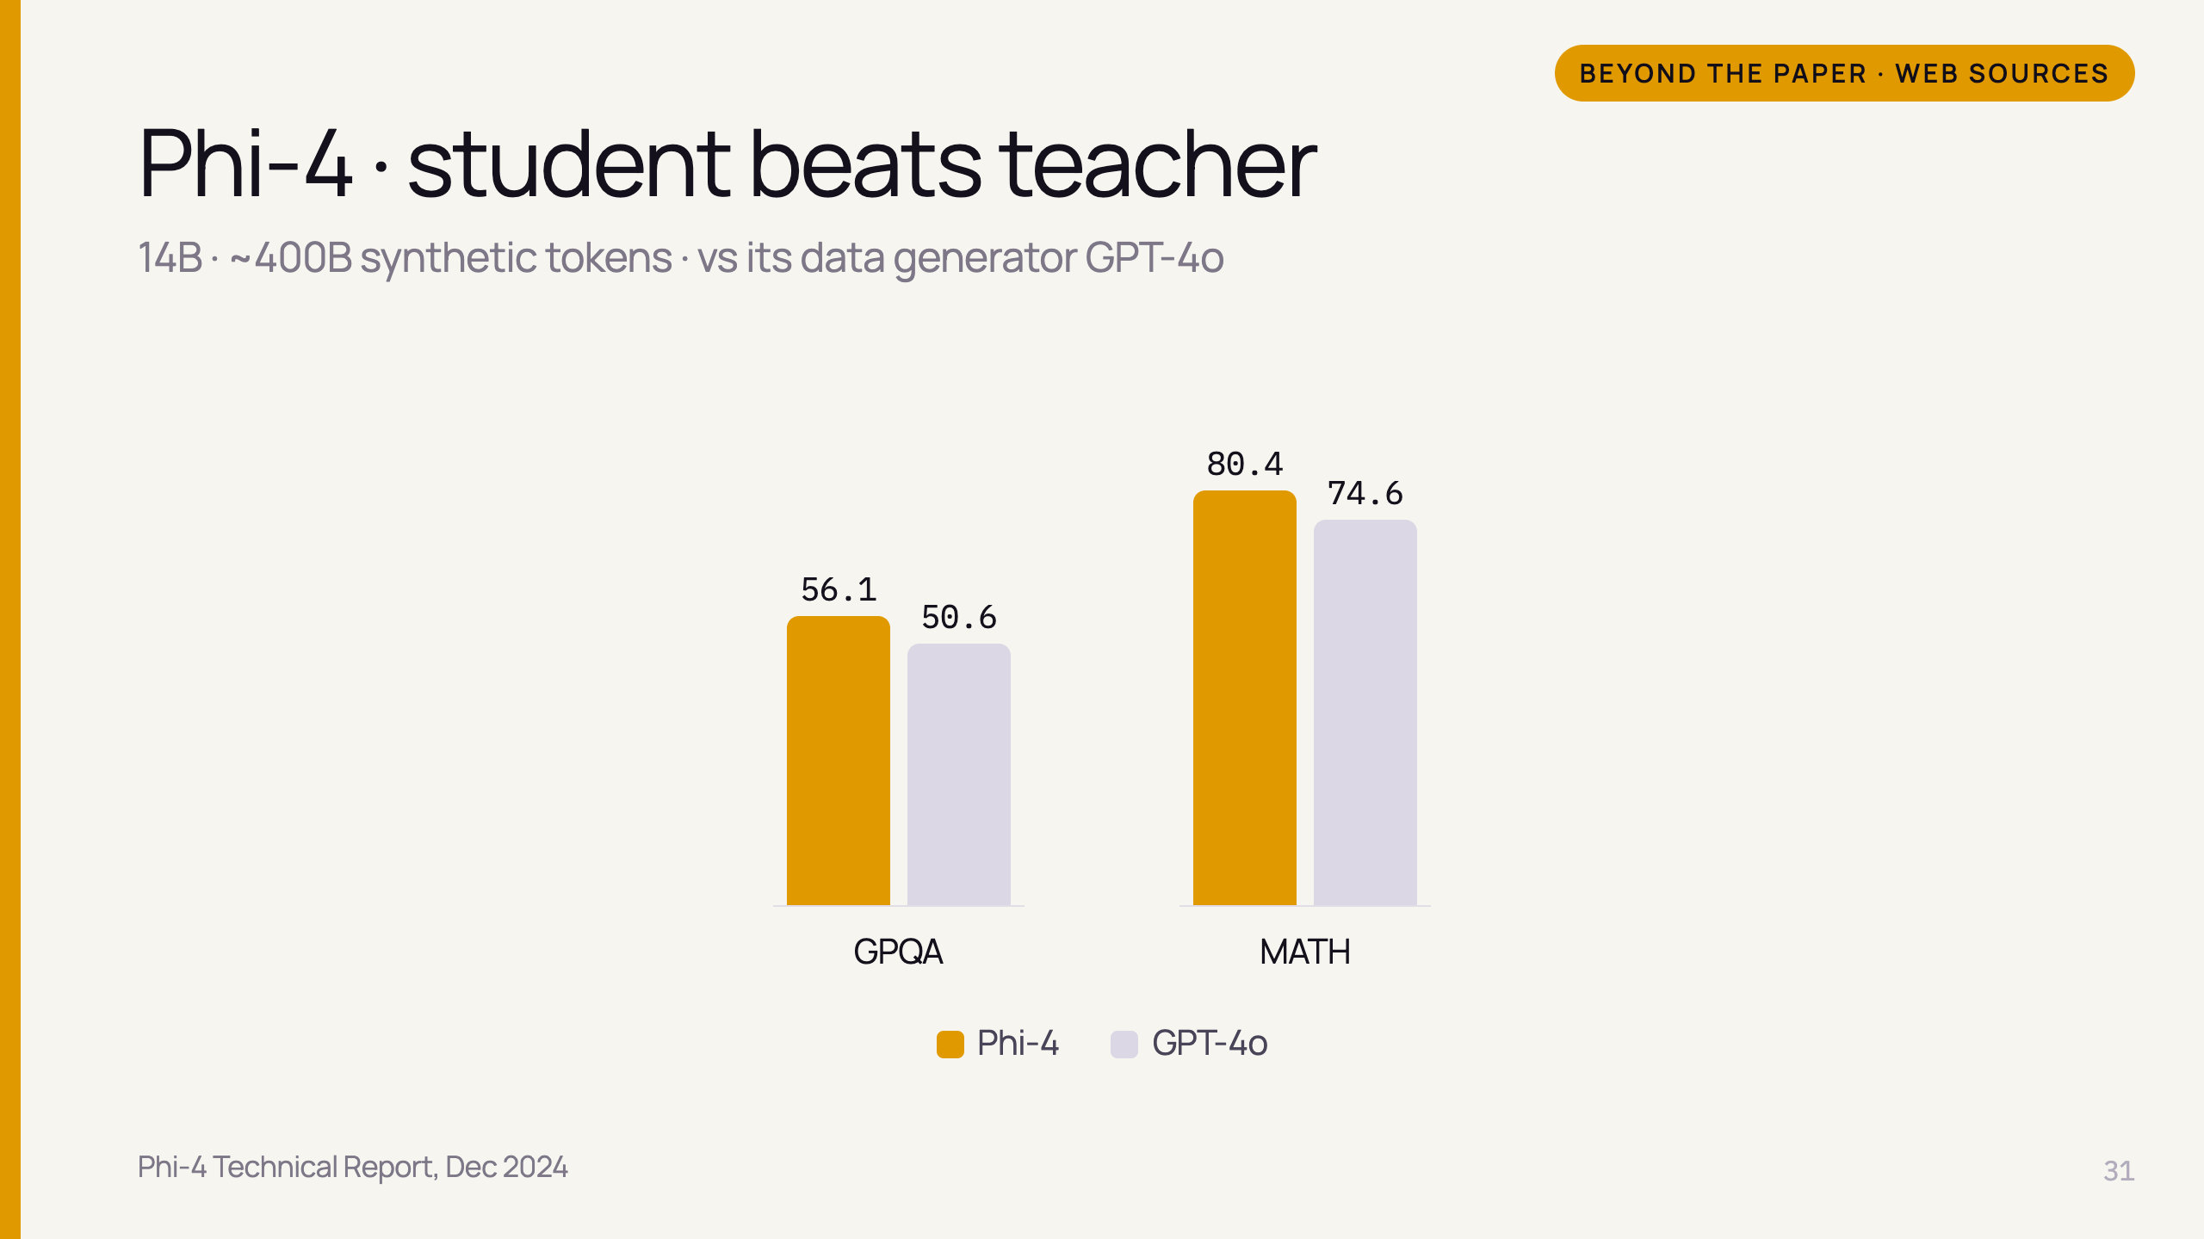
Notes:
- Techniques: multi-agent prompting, self-revision, instruction reversal — far beyond phi-1's random-topic trick
- phi-1 paper hinted: on narrow tasks student can beat teacher → here it happens

Slide 33
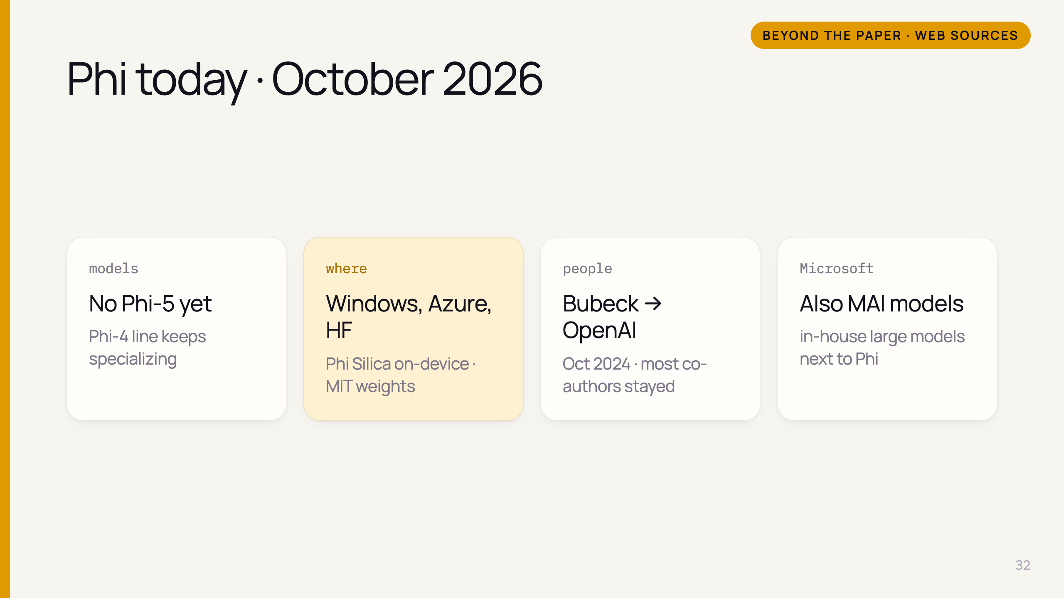
Notes:
- No announced Phi-5; "Phi-5 guides" online are speculation
- Phi Silica built into Windows Copilot+ PCs (NPU); Azure Foundry; Hugging Face, Ollama
- Sébastien Bubeck (Phi lead, co-author) moved to OpenAI Oct 2024
- Microsoft builds its own MAI frontier models; Phi = small-model track

Slide 34
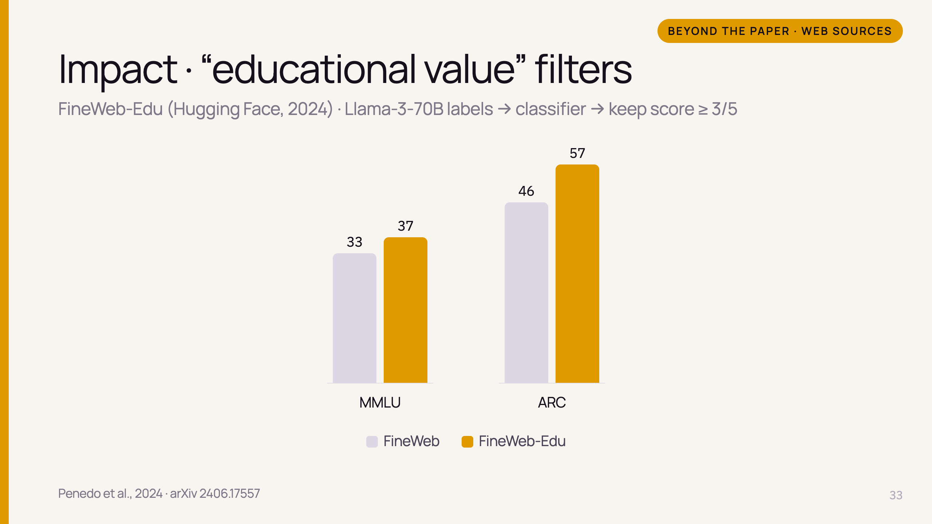
Notes:
- Exactly the phi-1 filter idea: LLM labels samples, small classifier scales it up
- Open version — Microsoft never released its classifier/data
- 1.3T tokens kept
- Same technique used in Llama 3 and Phi-3 pretraining (per FineWeb paper)

Slide 35
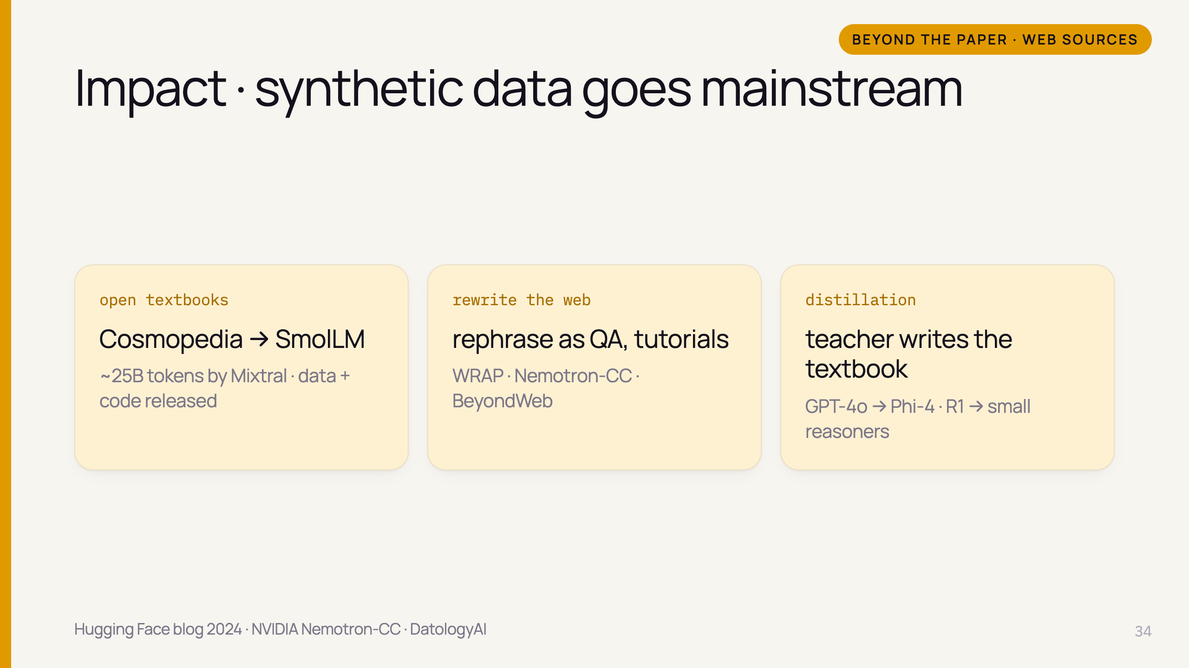
Notes:
- Cosmopedia: Hugging Face's open reproduction of phi-1.5 data; v2 is the synthetic core of SmolLM
- Rephrasing: middle ground between filtering and generating from scratch; now standard pretraining practice
- 2026 studies: structured formats (tables, FAQs, tutorials) beat curated web → textbook style wins
- Distillation through data: DeepSeek-R1 distilled into Qwen/Llama (Jan 2025), Phi-4-reasoning from o3-mini
- Small models everywhere: Phi-4, Gemma 3, Qwen3, Llama 3.2, SmolLM3 — the data recipe is the moat

Slide 36
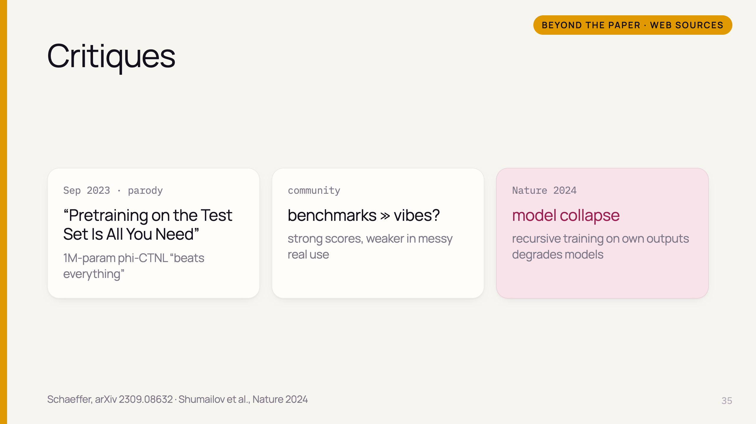
Notes:
- Satire inspired by phi-1.5 — joke about contamination; synthetic data close to benchmark format → suspicion
- Users often report Phi weaker in open-ended chat than benchmarks suggest — matches paper's robustness limits
- Microsoft later: fresh contests (Phi-4), publishing eval logs (2026)

Slide 37
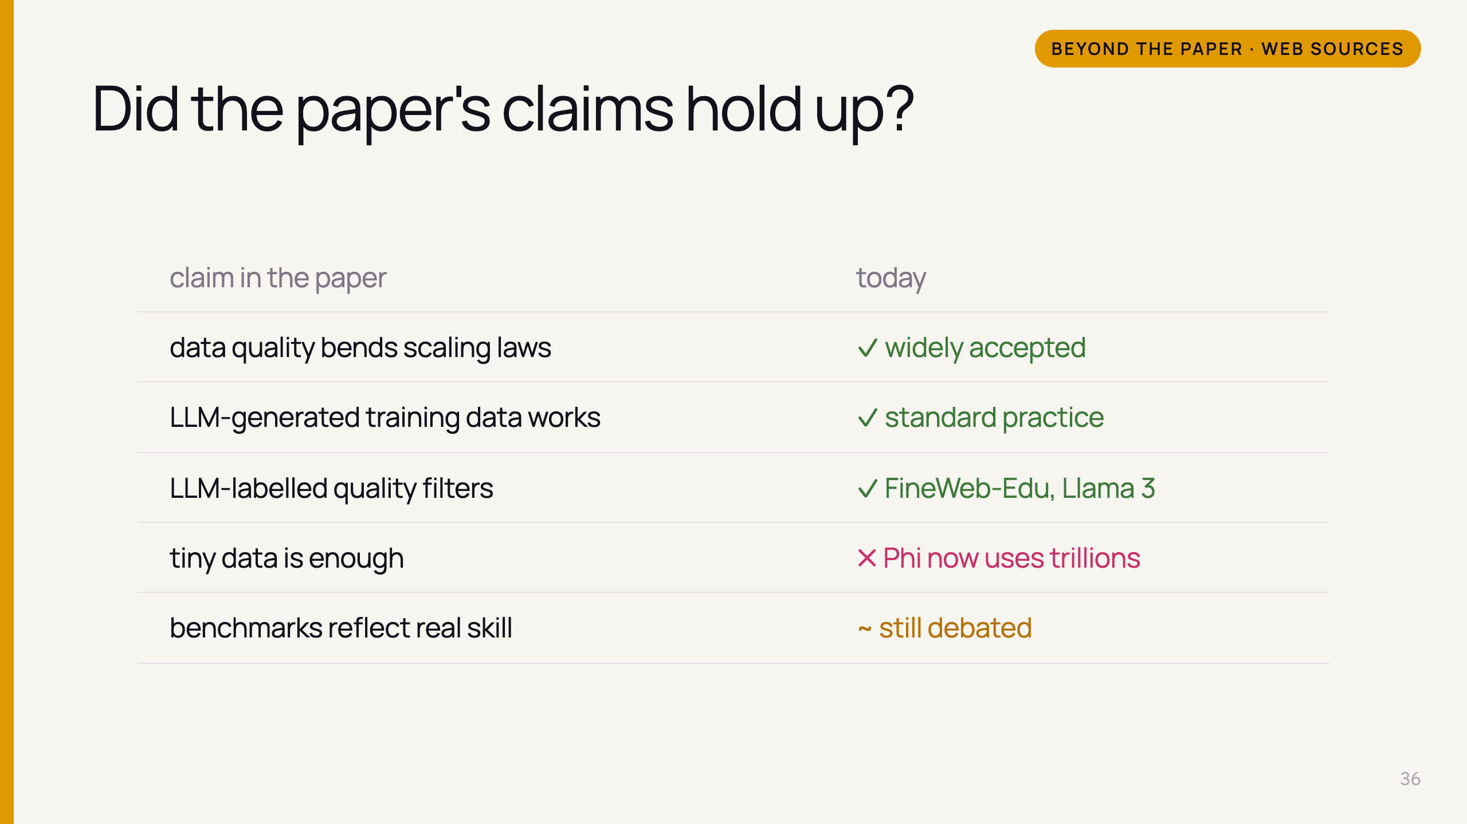
Notes:
- Core message survived and became mainstream
- "Less data" part didn't — quality AND quantity
- Robustness / benchmark trust remains open
- Size still matters (paper's own emergence finding)

Slide 38
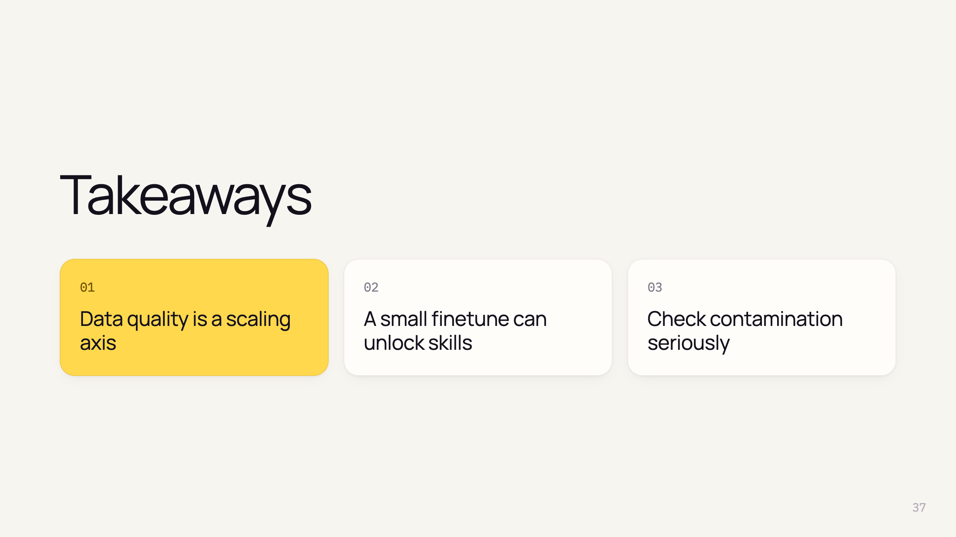
Notes:
- 1: textbook data → 10× smaller, 100× less data
- 2: 180M tokens, 29 → 51%, emergent API use
- 3: new problems, n-grams, pruning — a model for evaluation
- Bonus: the idea is now everywhere (FineWeb-Edu, Phi-4, distillation)

Slide 39


Slide 40
